Slide 1
Inpatient Management of Acute COPD Exacerbation (AECOPD)
Initial Assessment • Vitals & SpO2 • VBG (or ABG), CXR, BNP +/- trop if clinically indicated • Assess Severity
Immediate Management (Within First Hour) Oxygen: SpO2 88–92%, reassess ABG if CO2 retention Bronchodilators: Albuterol + Ipratropium Steroids: Prednisone 40 mg PO daily x5 days (or IV methylprednisolone if unable to take PO) Antibiotics per expanded criteria
Reassess Improving? → Continue bronchodilators & steroids, monitor closely, consider de-esc to LA nebulizer therapies if indicated Hypercapnia/Acidosis (pH ≤7.35, ↑PaCO2)? → Initiate BiPAP
Escalation of Care Review MOLST/Advance Directives ICU: Severe acidosis (pH <7.25), worsening hypercapnia, refractory hypoxemia Intubation: Respiratory arrest, severe encephalopathy, instability
Supportive Care • DVT prophylaxis • Early mobilization • Airway clearance-incentive spirometry/pulm toilet-aerobika • Active O2 weaning • Smoking cessation • Review inhaler technique
Discharge Criteria & Planning • Stable on room air or baseline O2 with improved symptoms and clinical findings • Minimal rescue bronchodilator need • Ambulating safely • Optimize maintenance inhalers and provide 30 day supply of ALL (LABA/LAMA ± ICS, SABA) • Pulmonary rehab referral • Vaccinations (Influenza, Pneumococcal) • Exacerbation action plan

Slide 2
COPD Management: Antibiotics For Routine Use?
Best Practice & LOS Considerations
Antibiotics are widely indicated in COPD exacerbation
GOLD*
UpToDate
Purulent sputum
Prior positive bacterial cultures
Invasive/non-invasive mechanical ventilation
Moderate to severe exacerbation
Worsening sx despite other usual tx
Low FEV1 (<50%)
Recurrent admissions
Prior hospitalizations past yr
Comorbid conditions esp HF/CAD
Advanced age (>65)
*Global Initiative for Chronic Obstructive Lung Disease

Slide 3
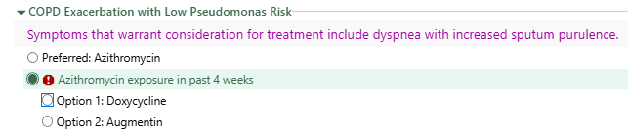
Antibiotic Options for COPD Exacerbations
Caveat: no recent sputum cx data or recent abx course of therapy exposure
Doxycycline, amoxicillin-clavulanate & azithromycin most widely studied
Pre-print retrospective study from 2025 looking at hospitalized COPD exacerbation patients receiving – beta-lactam, macrolide, tetracycline, or quinolone – conclusion was no significant difference between classes therefore use narrow spectrum agents – azithro / doxy
Azithro (3 days)vs doxy (5 days) – LOS lower with azithro & faster resolution of dyspnea with azithro
Kumar et al. Comparative Evaluation of Azithromycin & Doxycycline in Acute Exacerbations of COPD Eur J of Cardiovascular Medicine Vol 15:10:654-657
Additional benefits of azithro: shorter course of txt, reduction in cumulative amount of steroids required shown in one retrospective study.
Clinical data for azithro using 3x week prophylaxis shows reduction in exacerbations
Trials excluded azithro when QTc>450 ms

Slide 4
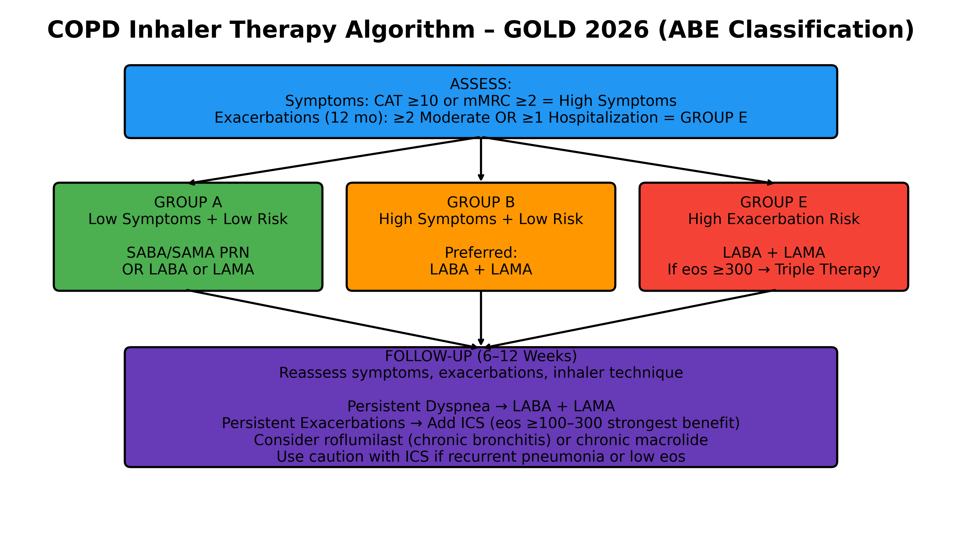
Notes:
CAT –COPD assessment score. mMRC dyspnea scale. Essentially not in play with this group as we are focused on essentially all group E patients. Triple Therapy is LABA/LAMA/ICS

Slide 5
COPD Single – Agent Inhalers
★= COPD Preferred (GOLD)
LABA ★ Indacaterol – Arcapta ★ Olodaterol – Striverdi Salmeterol – Serevent Formoterol – Perforomist Arformoterol – Brovana
LAMA ★ Tiotropium – Spiriva ★ Umeclidinium – Incruse ★ Glycopyrrolate – Seebri / Lonhala ★ Revefenacin – Yupelri Aclidinium – Tudorza
ICS Budesonide – Pulmicort Fluticasone – Flovent / Arnuity Mometasone – Asmanex Beclomethasone – QVAR Note: ICS NOT used alone in COPD

Slide 6
COPD Combination Inhalers
★= COPD Preferred (GOLD)
LABA + LAMA ★ Umeclidinium/Vilanterol – Anoro ★ Tiotropium/Olodaterol – Stiolto ★ Glycopyrrolate/Formoterol – Bevespi Aclidinium/Formoterol – Duaklir
LABA + ICS ★ Budesonide/Formoterol – Symbicort ★ Fluticasone/Vilanterol – Breo Fluticasone/Salmeterol – Advair Mometasone/Formoterol – Dulera
Triple Therapy (LABA + LAMA + ICS) ★ Fluticasone/Umeclidinium/Vilanterol – Trelegy ★ Budesonide/Glycopyrrolate/Formoterol – Breztri

