Slide 1
Discharge Process Inpatient to Home or Self Care
Using Epic to manage discharges efficiently and ensure all required discharge needs are addressed.
September 2024

Slide 2
Discharge Requirements per CHS Policy
The provider order is necessary for a patient to be discharged from the hospital
Medical Staff Responsibilities
Instructions’ for patients being discharged to home can be given by a provider and will include
Diet
Activity
Medication prescriptions
Signs and symptoms to report to provider
Follow-up appointment instructions
Wound Care orders for patients with active wounds, pressure injury, lines or artificial airway
Additional instructions If the patient is being discharged to another level of care (e.g. rehab, SNF etc.), a Discharge / Transfer summary or additional required forms should be completed (EMTALA, Ambulance Transfer, etc.)

Slide 3

Let’s deal with that computer and Epic
I need to place all my discharge orders and make sure my patient can take care of themself at home.
How do I do this in Epic?

Slide 4
Table of Contents
Patient has been determined clinically ready for discharge
Using the Discharge Navigator
Entering the Discharge Orders
Searching DME for diabetic patients
Problem List
Adding Instructions for post hospitalization care
Creating a pending discharge
Adding a discharge summary
Reviewing and validating all orders and information

Slide 5
Discharge Navigator
Use the Discharge Navigator appropriate for the discharge
Discharge tab This is for most discharges and the focus of this presentation
Discharge/Readmit tab is for patients going to another CHS Facility
Note: when a patient is being discharged to another CHS facility (like transfer for specialty service or MRU) Epic is looking for reconciliation to be done here and staff will not be able to print AVS until completed. If you believe this is in error, confirm disposition on the discharge order
Discharge Deceased tab is for expired patients
The key for this is the death date and time
Review and update the Death of a Patient section
No discharge order is needed
Medication reconciliation is not required

Slide 6
Discharge Navigator
Use the index of the Navigator and review/complete each section
Ensure all orders are cosigned – the admission order must be cosigned by a Physician before a discharge order can be placed.
Ensure no inappropriate signed and held orders remain for the visit – address these by discontinuing those that are no longer needed. Any orders in this state that should have been carried out and were not should be brought to the attention of the nurse for follow up.

Slide 7
Patient Directed Discharge (PDD) - Definitions
Some patients will request/insist on discharge – or just leave the hospital without collaborating on the discharge process - even though the provider feels they should not leave. This group encompasses several different situations, all of which are referred to as “Patient Directed Discharges” rather than the prior derogatory terminology “Against Medical Advice” (AMA).
Types/subtypes include but are not limited to:
Provider does not agree that the patient is medically appropriate to be discharged at this time, but the patient is still insisting on discharge despite clear discussion of risks of discharge
Patients who abscond and are not involved in discussions about discharge

Slide 8
Patient Directed Discharge (PDD) - processes
Absconding patients – clearly document in the chart what occurred, try to contact patient as well as HIPAA-authorized patient contacts using any contact information available in the chart. Additionally try to contact outpatient provider when there is an identified provider. Document those contact efforts and the results of those efforts.
For all other Patient Directed Discharges, use the same tools as you would for any other discharge to home or self care.
Provide post hospitalization discharge instructions, including: diet, activity, signs and symptoms to report to provider, follow-up appointment instructions and wound care orders for patients with active wounds, pressure injury, lines or artificial airway
Perform discharge medication reconciliation and ePrescribe any appropriate medications
Clearly identify in your discharge note and summary the risks and benefits of the patient directed discharge that have been explained and reviewed with the patient.

Slide 9
Patient Directed Discharge - cautions
Signing “AMA” forms - this process is typically confrontational and pejorative, however an attempt should be made to have the patient sign these forms in a collegial and non-confrontational fashion. If the patient declines to sign, then document the effort and continue the discharge process
Safety - Any PDD patient that is thought by medical staff or hospital associates to pose a hazard in the community such as driving in an unsafe condition should trigger notification to local law enforcement for intervention.
Competency Refer to policy # CHS-LS-RSK-023 for details regarding any patient demonstrating mental lack of capacity

Slide 10
Let’s deal with that computer and Epic
Is there an easy way to place all my orders for post hospitalization care?

Slide 11
Discharge Reconciliation
This area of the record must be completed accurately to ensure a proper med list for the patient appears on their after visit summary (AVS)
Address any changes to medications when reviewing the home medication list
Add any additional medications to be ePrescribed
When performing medication reconciliation pay attention to start/stop dates for medication orders. Medications that are expired will not flow to downstream systems as expected and may cause confusion for patients after discharge.
Reminders to patient to communicate with their PCP may be required.

Slide 12

CHS Discharge Order Set
Where is my discharge order??!
The actual order for discharge is being moved into the CHS Discharge to Home order set to help providers to ensure all policy requirements are met. This has not changed for procedural workflows.
Select the orderset that is prompted
q GEN Discharge: Home or Self Care
The mandatory sections in the order set will help ensure the appropriate discharge orders are placed
Enter the desired discharge orders using the order set
Be certain to address any post hospitalization care needs including wounds, incisions and pressure injuries, referrals
Be sure all medications are updated and reviewed

Slide 13
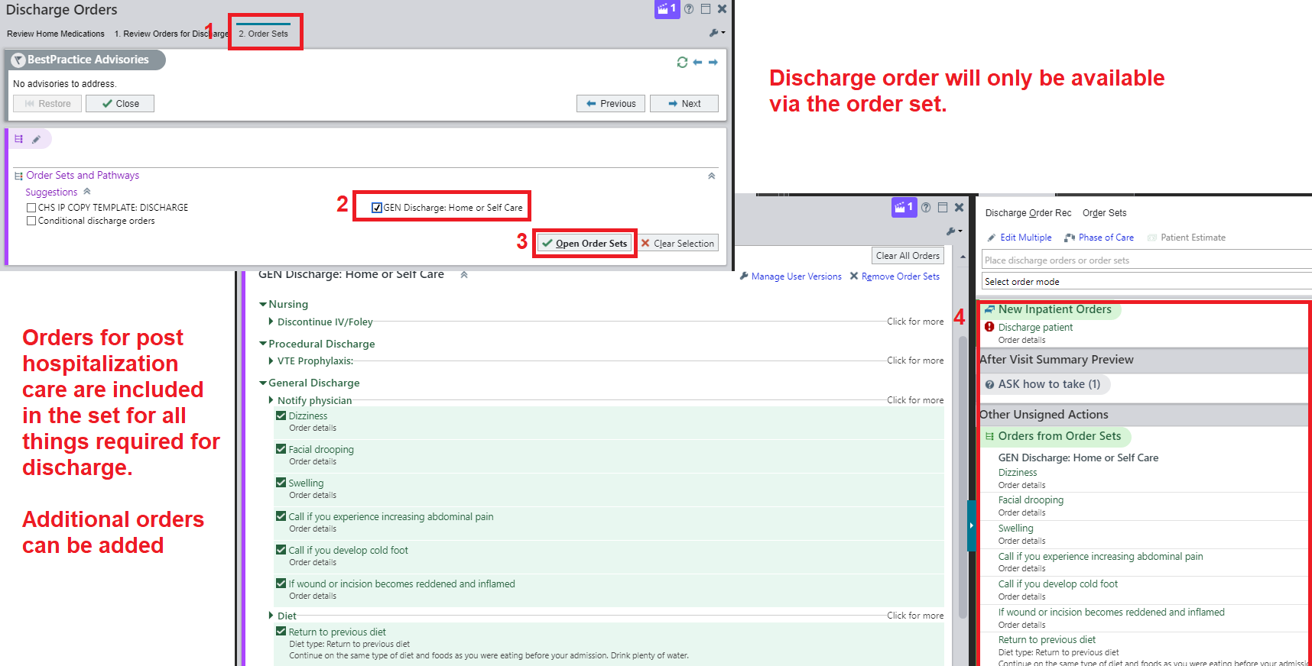
Discharge Order Set from Navigator

Slide 14
Let’s deal with that computer and Epic
What about Durable Medical Equipment and supplies?
How do I do this in Epic?

Slide 15
DME Supplies
Adding DME orderables at the time of discharge will place these items as outpatient orders for the patient to use after their visit. (walkers, beds, diabetic supplies etc.)
You will need to work with the case manager to ensure some of the items for home needs are ordered and delivered
You may need to work with wound advisors for patients with complex skin care needs to ensure all dressing needs are ordered

Slide 16
DME – Diabetic Supplies
Be sure you are logged in to your appropriate hospital virtual department
Search for the brand name of the product example: Verio
When you search for a synonym you may receive the generic list and will need to search through for brand name products you want to order; any item with AKA in the name is dispensed as generic from the community pharmacy
Be sure Dispense as Written is selected on your order

Slide 17
Additional Orders
When you are in the discharge navigator order section and are placing any follow up orders for tests or procedures they will appear on the AVS if placed while you are in the discharge navigator
Actively using the discharge navigator gives these orders a phase of “Discharge Orders”
Search and add any additional orders for the patient to follow post hospitalization

Slide 18
Let’s deal with that computer and Epic
Why, why, why do I need to deal with this problem list?!

Slide 19
Problem List
The entries on the problem list are used to prompt diagnosis related items in the record
Additionally the problem list follows the patient to our clinics and outpatient settings for continued care
Ensure all problems are reviewed and updated
Resolve problems that are no longer relevant
Update problems that are not resolved
Select Mark Reviewed button
The problem list is also used by the coders to ensure proper billing

Slide 20
Let’s deal with that computer and Epic
What is this Instruction section for?

Slide 21

Instructions for Post Hospitalization Care
Use the Instructions section to add any instructions that are needed for post hospitalization care and management
This information will go to the AVS and the patient’s MyChart.
Select the green plus sign for suggested education topics that have standardized reference information and videos for the patient to watch, when adding videos the patient will receive a QR code to scan with their device to view videos
You can search for additional topics using the Clinical References hyperlink
Use the free text section for additional information
Can use a smart text/smart phrase here
Can free text and use Dragon here
Scan QR to View

Slide 22
Let’s deal with that computer and Epic
Can I prepare a patient for discharge ahead of time?
How do I do this in Epic?

Slide 23
Preparation for Discharge – things to consider…
You can create your discharge order and perform medication reconciliation in advance of expected discharge date up to 48 hours in advance.
It is advised that caution be used when doing this any subsequent medication orders would need to be addressed in med rec on the fly. (Med Rec on the Fly document can be found on the Learning Home Dashboard.)
The discharge order would be active and in place for all clinical staff. Enter the expected future date/time of the discharge on the order. An active discharge order must be present to perform med rec on the fly.

Slide 24

Preparation for Discharge – things to consider…Cont’d.
You can prepare discharge orders in advance of the discharge without restriction as long as the orders are in a pended state. The medication reconciliation would not take place at this time. The next provider entering the discharge navigator would see and be able to release the work already set up and would become the author of that work. This is invoked by selecting Save Work – Complete Later
Any authorized provider can review and release your pended discharge orders.
Note: Future outpatient orders can be placed early on the Manage orders activity, reconciliation should not be done early as that sends information out to the community pharmacy as soon as it is completed.

Slide 25
Discharge Summary
The discharge summary can be initiated by Provider A.
The provider creating the discharge summary selects Share on the bottom of the note.
On the day of discharge Provider B can edit the discharge summary and becomes the owning author of the discharge summary.
The provider creating the discharge summary selects Share on the bottom of the note.
Best Practice is to use the CHS Discharge Note Template
Pulls in discharge orders placed on the patient
Pulls in other patient specific information into the note

Slide 26
Let’s deal with that computer and Epic
What is an AVS?
How do I know that the discharge orders are reflected appropriately in the chart and are available for the patient?

Slide 27
Validating Discharge Orders
An AVS is the After Visit Summary provided to the patient on paper and in MyChart telling them how to care for themselves after discharge
Click on the AVS button to preview the information being sent to the patient
The AVS generated is specific to the patient type (medical, surgical, outpatient…)
The RN will review all this information with the patient, family and/or caregiver and ensure all understand the information
The information on the final AVS is sent to MyChart for the patient to have access to at any time from their personal device
All downstream systems will have access to the information they need
You can also review the Order History using the filter for Discharge Orders

Slide 28
All done! On to the next patient!

