Slide 1
Blood Culture Vial Shortage
Beckton-Dickinson (BD) has ongoing supply issue with their blood culture bottles in the manufacturing process of the plastics used in the bottle
Company states this will last into September, but may last longer
In a typical month 4000 blood cultures collected at CH
52% ED, 47% Inpatient Units; most positives are from admit (ED)
Many inpatient blood culture orders are performed in very low yield circumstances
Changes to Blood culture order set made to help guide proper use in Epic
Blood culture collection education sent out again to staff to reduce contamination

Slide 2
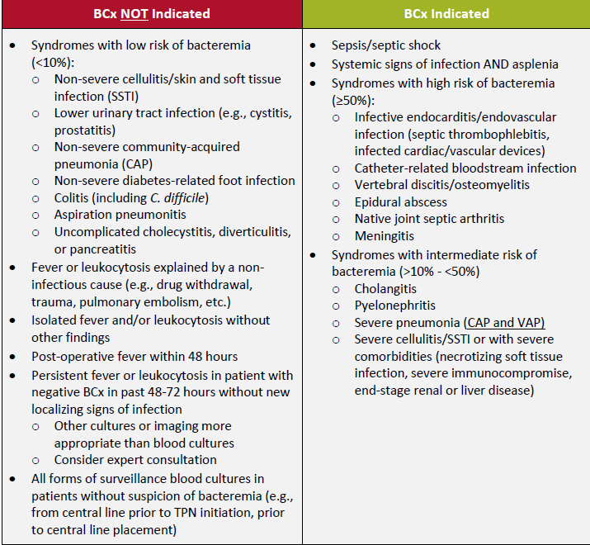
Best practice is to collect "2 sets" of blood cultures. Due to the major shortage we advise that only one set of blood cultures is ordered at a time.
As a reminder, 1 set = 2 blood culture vials, so for many providers at CH this will not be an apparent change. [In the Longterm, when supplies are back, we continue advocating a 2 set approach, but that will have to wait given the circumstances.]

Slide 3
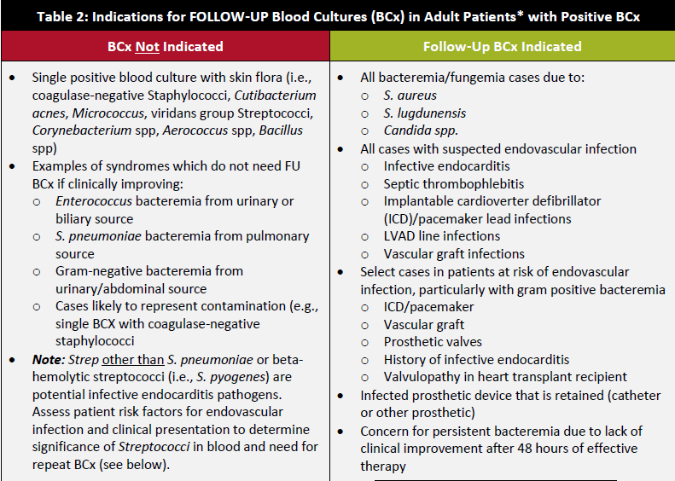

Slide 4
A note on Fungal Blood Cultures…
Routine blood cultures are equivalent to fungal blood cultures for detecting common yeasts, such as Candida spp and Cryptococcus spp
Pathogens such as Aspergillus spp and Mucorales spp are very rarely found on fungal blood cultures and are better detected using biopsy with tissue culture or serologic studies (Aspergillus galactomannan)
If concerns for Histo/Cocci/Blasto ,non-culture based studies specimens often more reliable and faster

