Slide 1

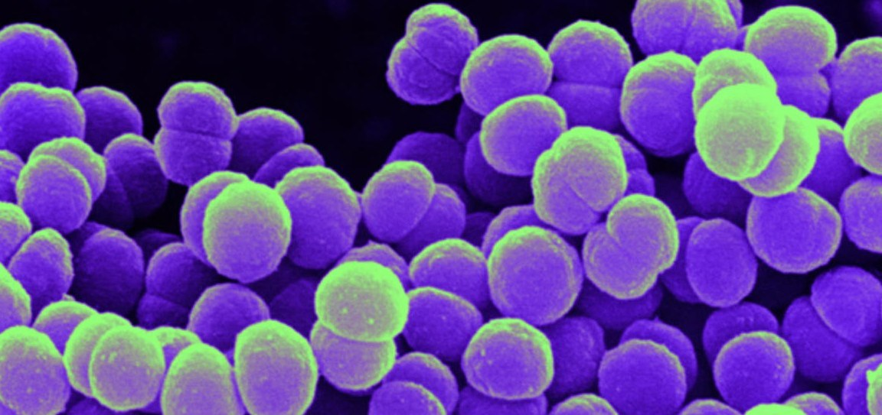
Severe Sepsis/Septic Shock
Presented by CDI, HIM, and CDAD
June 2022

Slide 2
“Denials”
At Catholic Health denials are worked by the Clinical Denials and Appeals Department (CDAD)
What is a Denial?
Every patient has a claim sent to their Insurance Carrier which specifically outlines all care rendered for treatment of Principle diagnosis, secondary diagnoses, and any procedures.
The insurance company reviews the claim and all diagnoses submitted, then performs a thorough review of the medical record to ensure all diagnoses are well supported, monitored, and treated accordingly.
When insurance company reviews the record and finds lack of clinical support, conflicting documentation, lack of treatment for a diagnosis etc., they notify the hospital organization via a denial letter that they are removing a diagnosis from the claim and state their reasons for doing so.

Slide 3
Appeal Process
Denial letter is reviewed by Clinical Denials and Appeals Team, followed by thorough review of the medical record.
Along with assistance from the Physician Advisor, an appeal letter is generated stating our case as to why Catholic Health feels the diagnosis is valid and supported in the medical record.
The Appeal letter includes specifics taken right from the documentation in the medical record along with all supportive clinical indicators. It is sent to the Insurance Carrier within 30 days of receipt of denial letter.
No Appeal Process
Denial letter is reviewed by the Clinical Denials and Appeals Team, followed by thorough review of the medial record.
With assistance from Physician Advisor, if the reviewed record does not have the proper documentation and clinical support to validate the denied diagnosis, Catholic Health does not send an appeal to the Insurance Carrier. In other words, Catholic Health is in agreement with the Insurance Carrier that the stated diagnosis is not clinically supported.

Slide 4
If Appealed, Appeal letter is sent to Insurance Carrier. If the Insurance Carrier:
Agrees with Catholic Health
Disagrees with Catholic Health
Original diagnosis that was denied is re-instated and Catholic Health receives full value for resources associated with patient encounter.
Catholic Health receives the appropriate severity of illness, risk of mortality, and more accurate length of stay for patient encounter.
More accurate reflection of the Hospital’s CMI (Meaning your are caring for very sick patients)
Catholic Health can choose to do no further appeal, and the diagnosis is removed from the patient’s claim.
Catholic Health can choose to try second review with the insurance company.
If the second review is still upheld Catholic Health can choose to send for a third review to an Outside company.
The Outside Company does a thorough review of the patient’s record hearing both sides, and makes a non-biased decision on the validity of the diagnosis.
Whomever the decision is in favor of, the other must pay the Outside Company for their services.

Slide 5
When an Appeal :
IS LOST
Diagnosis is removed from patient’s claim. This indicates you never took care of patient for this during their stay.
This leads to Catholic Health returning resources to insurance company.
This leads to lowering of patient’s SOI/ROM for said visit, which also lowers what their length of stay should have been.
This lowers the Hospital’s CMI (Case Mix Index). A low CMI indicates you are not caring for very sick patients.

Slide 6
We Are Here to Help You!
CDI Specialists
CODING Specialists
CLINICAL DENIALS
Specialists (CDAD)
Review the medical record and all documentation while patient is in the hospital.
Place queries/talk with the Provider to obtain clarification, more specific documentation and to alert Provider of conflicting and/or inaccurate documentation.
Goal is to obtain a complete and accurate record before the patient is discharged.
Review the medical record and all documentation after the patient is discharged.
Final codes record and sends to billing department for final claim to the Insurance Carrier.
Also query if there is inaccurate, conflicting documentation or if further clarification is needed in the medical record.
Goal is to obtain a complete and accurate record.
Review the closed records documentation after the Insurance Carrier has denied a diagnosis.
Team up with the Physician Advisor to effectively determine medical necessity, to locate and identify crucial medical record documentation in order to support the denied diagnosis and Appeal to the Insurance Carrier.

Slide 7
Encounters With Denial Letters Received

Slide 8
Sepsis Documentation
Case Scenario 1
Patient with Myasthenia Gravis, permanent trach & vent dependent presented with dyspnea and body wide pain. Has known LE Venous Ulcerations. In ED, RR 22-24, HRs 95-100, WBC 21.7, Na 119, Creatinine 2.84 (No baseline SCr documented); Admitted with Cellulitis of Buttock, Cellulitis of lower leg, Sepsis and Acute Renal Failure. Patient initially admitted to the ICU, and was hospitalized for 16 days.
Original DRG
Revised DRG after a Second Level Review Denial
DRG: 720 (Sepsis & Disseminated Infections)
SOI: 4
ROM: 4
Claim total charges: $73, 109.91
Original Reimbursement: $50,128.53
DRG: 383 Cellulitis and Other Skin Infections
SOI: 4
ROM: 3
Revised Reimbursement: $43,758.11
Recovery Amount Due: $ 6, 370.42
DRG denial was based on:
Lack of consistent documentation in the medical record:
  No documentation of supporting indicators for Sepsis: only “sepsis” is documented in H&P.
  Sepsis then not documented until 8 days later, as a free text note → never incorporated in daily progress notes.
  Sepsis not documented again until another 8 days later (which is day of DC). Not listed as a discharge diagnosis, only a mention in the Hospital Course.
Physical Exam Findings ‘’not in acute distress, cooperative pleasant” upon admission.
Physician not linking the organ dysfunction to Sepsis and acute renal failure only documented in the H&P

Slide 9
Sepsis Documentation
Case Scenario 2
Patient with chronic CHF, HTN, CAD, & COPD presented with dyspnea and cough. ED Vitals: 104/41- 52-18; Temp 95.7; 88% on r/a → 2L O2 96%. WBC 14.2 with left shift; lactate 2.5, SCr 2.46 (baseline SCr 1.8). Chest Xray revealed opacities RML & RLL and mild perihilar vascular congestion. BNP 602; Troponins 393, 482. Admitted for Severe Sepsis 2/2 Pneumonia, AKI, Acute on chronic systolic CHF, Acute hypoxic respiratory failure. Hospitalized for 5 days. Cardiology Consult: Type 2 MI due to demand
Original DRG
Revised DRG after Denial
DRG: 871
SOI: 4
ROM: 4
Claim total charges: $15,724.61
Original Reimbursement: $8,083.41
DRG: 193 Simple Pneumonia
SOI: 3
ROM: 3
Revised Reimbursement: $6,091.20
Recovery Amount Due: $1,992.21
DRG denial was based on:
Lack of consistent and supportive documentation in the medical record:
  Admitting Provider who wrote admission order for Sepsis did not include Sepsis in the H&P
  No IVFs or Antibiotic in the ER. Severe Sepsis Protocol not initiated. Patient did not receive IV antibiotics till 5 hours after admission.
  No treatment for AKI (no IV Fluids given, and no contraindication to IVFs documented); Maintained on 2L O2 entire hospital stay and no treatment for acute component of CHF – remained on home dose of po Bumex
  DC Summary: “Sepsis with acute organ dysfunction” → no organ dysfunction listed as a diagnosis. Hospital course informs patient required cautious IV fluid resuscitation, however, no order for IVF, and no documentation that patient received any IVFs (inconsistent documentation)
Physical Exam Findings: ER MD “non-ill/non-toxic appearing”: 1st PN: “I feel pretty good”, pt. “not in acute distress”, “patient euvolemic on exam”, Resp Status stated by all “pulmonary effort normal, no respiratory distress”; “WDL”, “no SOB”. Only had one episode of desaturation which was on ambulation.
Physician not linking the organ dysfunction of Type 2 MI to Sepsis

Slide 10
Sepsis Documentation
Case Scenario 3
81 y/o female with history significant for cholangiocarcinoma, Primary Biliary Cholangitis who was diagnosed with UTI 7 days PTA, treated with a course of Bactrim. Failed outpt treatment & presented to hospital with c/o of fever, weakness. Febrile with a T 101.2 F & hypotensive with BP 99/56 - 82/49. Despite her recent 1 week course of antibiotics her UA was notable for pyuria (11-20 WBC) and she was complaining of urgency and pelvic discomfort. Admitted with Sepsis secondary to UTI and hospitalized for 3 days.
Original DRG
Proposed DRG by Insurance
Final DRG after Appeal Won
DRG: 872 (Sepsis or Severe Sepsis
without MV >96hrs without MCC)
SOI: 3
ROM: 3
Claim total charges: $9,908.33
Original Reimbursement: $6,265.74
DRG: 690 (Kidney and Urinary
Tract Infections without MCC)
SOI: 2
ROM: 2
Revised Reimbursement: $2,873.15
Recovery Amount Due: $3,392.59
DRG: 872 (Sepsis or Severe Sepsis
without MV >96hrs without MCC)
SOI: 3
ROM: 3
Insurance Reversal: $3,392.59
Final Reimbursement: $6,265.74
DRG WIN was based on:
Consistent and supportive documentation in the medical record:
  Sepsis was clearly, consistently and appropriately diagnosed by the admitting provider, in the daily progress notes along with status updates. Discharging provider documented Sepsis secondary to UTI present on admission as discharge diagnosis in the DC Summary.
  Admitting Provider “Sepsis 2/2 UTI with fever, hypotension, and bandemia”.. Plan “IVF resuscitation, Ceftriaxone, Flagyl
  Sepsis secondary to UTI documented in daily progress notes with status updates “Sepsis improving- T max 37.8, BP low but stable, bandemia resolved”; “Urinary urgency/frequency improving”: “Will stop IVF’s given CHF hx and patient taking po” Minimal cut and paste – progress note updated and accurately reflected patient’s response to treatment rendered.
  Sepsis protocol was followed, patient received 3000ml IV fluid bolus and remained on IVF’s for 48hrs. IV abx (ceftriaxone & flagyl).
  Physical Exam Findings: “fever”, “weakness”; “feeling better but appears very fatigued”
Physician related the hypotension to Sepsis using “with”. Can also use terms such as ‘’due to”, “related to”, “as evidence by”

Slide 11
So, When it Comes to the Patient’s Medical Record:
Your documentation is looked at by many to make sure it is accurate, valid, and complete.
Be cautious when using cut and paste. You do not want to carry forward any inaccurate or old information. It can be seen by all.
Make sure your physical exams give a clear picture of what the patient looks like at the time you are completing it.
Be sure to individualize and update your documentation daily to ensure the documentation is most accurate.

Slide 12

Redefining Sepsis
Severe Sepsis and Septic Shock impact approximately 50,000 patients in NY State every year.
Before the implementation of NYS Sepsis Care Improvement Initiative, 30% of these patient’s, on average, died from this syndrome.

Slide 13
NYS Sepsis Care Improvement Initiative
“Surviving Sepsis Campaign”
Early detection of severe sepsis combined with timely and appropriate interventions saves lives!
NYS Regulations (Sections 405.2 and 405.4) require all NYS Hospitals that provide care to patients with Severe Sepsis develop and implement a Severe sepsis protocol.
Hospitals were able to develop their own protocols, however, Hospitals were given minimal requirement instructions:
  Had to be based on evidence - based guidelines
  Have targeted timeframes for critical interventions
    Measurement of a blood lactate level
    Collection of blood cultures
    Administration of broad spectrum antibiotics
    Fluid administration
    Fluid status assessment
    Vasopressors and re-measurement of lactate for eligible patients
Notes:
Every hospital in NYS that provides care to Septic patients is legally responsible for the quality of patient care services and for ensuring compliance to Federal, State, and Local law. NYS stepped in 2013 and initiated the NYS Sepsis Care Improvement Initiative (also known as the Surviving Sepsis Campaign) as the Mortality rates of patients with Sepsis was overwhelming. The intent is to identify Sepsis in its early stages and intervene in order to improve the outcome for the patient → meaning to decrease the mortality rate.

Slide 14
NYS Sepsis Care Improvement Initiative
“Surviving Sepsis Campaign”
Each Hospital was required to submit their Severe Sepsis/Septic Shock Protocol to the NYS Department of Health for review followed by implementation of the protocol
Every Hospital in NYS that cares for Severe Sepsis patients is required to report data on all diagnosed cases of severe sepsis/septic shock
The NYS Department of Health then aggregates this data and publishes this data for all to see.
CMS requires Hospitals to abstract specific data on Severe Sepsis/Septic Shock patient’s and also publically reports this data. It is a core measure.

Slide 15

Early recognition/Diagnosis Pathway
Severe Sepsis/Septic Shock
Is there a possibility or confirmed infection
Does not meet criteria to proceed further – Reassess as needed
NO
Reassessments Completed:
  ED: Every 2 hrs
  In – patient: Q shift
YES
Patient has 2 or more of the following present:
Temperature > 38.3 C (100.9 F) or < 36.0 C (96.* F)
Pulse > 90 bpm
Respiratory Rate > 20/min
WBC > 12 or < 4 or > 10% bands
Severe Sepsis/Septic Shock
Protocol
NO
Assess and document mental status on all patients in the ED
YES
Begin treating the
Infection
WITHIN ONE HOUR of recognition
DRAW LACTATE ACID
CMP
COAGS
CBC with diff
Is Organ Dysfunction Present
WITHIN ONE HOUR
Evaluate signs for organ dysfunction
Start as soon as possible not to exceed THREE HOURS
Administer Fluids 500ml q 15 min to a total of 30 ml/kg or MAP > 65
Obtain blood cultures
Start antibiotics
VS q 15 min x 90 min then q 60 min
Repeat lactate in 3 hours
Start Vasopressors if MAP </= 65 after fluids
See Order Sets
Severe Sepsis (SIRS + organ dysfunction)
Hypotension (BP < 90/60 or MAP < 65mm/Hg
Areas of mottled skin
Creatinine > 2.0 mg/dl
Platelet count < 100,000
Acute renal failure or urine output 0.5mg/kg/hr
Hepatic Dysfunction – Bilirubin > 2 or INR > 1.5
Respiratory Failure
Metabolic Encephalopathy
Lactate >2
YES
NO
Document the source of infection and treat
Reassess for signs of
Organ dysfunction
Notes:
Identification of early sepsis has been proven to reduce Mortality. CMS (Centers for Medicare and Medicaid Services) continues to support SIRS, Sepsis and Severe Sepsis, however, SCCM (Society of Critical Care Medicine) no longer includes SIRS in the definition of Sepsis because SIRS isn’t always caused by an infection- SIRS may occur in several conditions not related to Sepsis such as autoimmune disorders, vasculitis, thromboembolism, burns or surgery. The Society of Critical Care medicine defines Sepsis as a life threatening organ dysfunction caused by a dysregulated host response to Infection.
The Society of Critical Care Medicine has established that Sepsis typically presents with hypotension, tachycardia, fever, and leukocytosis and as its severity worsens, signs of shock (cool skin, cyanosis) and organ dysfunction develop.

Slide 16


Severe Sepsis/Septic Shock
Protocol continued
Early recognition/Diagnosis Pathway
Severe Sepsis/Septic Shock
Evaluate for Septic Shock
Septic Shock
Severe Sepsis PLUS Refractory Hypotension
BP <90/60 or MAP < 65 despite adequate fluid resuscitation
Lactic Acid >/= 4
WITHIN SIX HOURS
Achieve hemodynamic stability with Fluids and Vasopressors
Consider CVP Line if: MAP< 65 despite fluid resuscitation or lactic acidosis persists
Obtain Source Control for Infection
Repeat Physical Exam

Slide 17
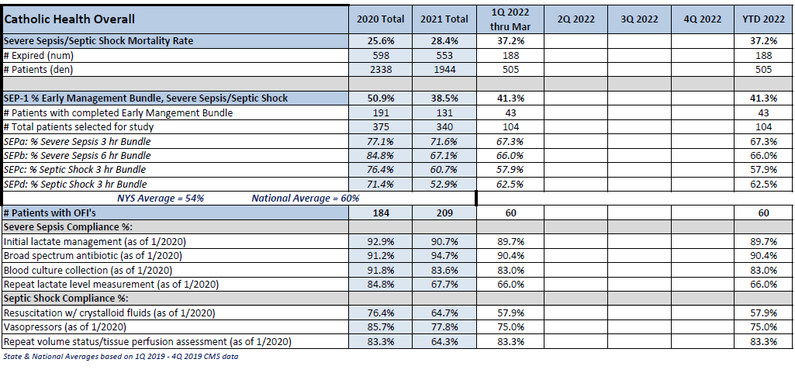
CMS Severe Sepsis Core Measure Dashboard
Catholic Health Overall

Slide 18
Out With the Old!
No More Sepsis in the documentation!
2 or more SIRS + Pneumonia = A Diagnosis of Pneumonia
2 or more SIRS + UTI = A Diagnosis of UTI
2 or more SIRS + COVID = A Diagnosis of COVID
2 or more SIRS + BLE Cellulitis = A Diagnosis of BLE Cellulitis
DOCUMENT THE INFECTION and TREAT.

Slide 19


In With the NEW!
(SIRS + Infection + Organ Dysfunction)
= Severe Sepsis
(Make sure to link organ dysfunction with a statement!! Listing diagnoses in problem list is not sufficient)
2 or more SIRS + Pneumonia + Acute Respiratory Failure = SEVERE SEPSIS SECONDARY TO PNEUMONIA WITH ASSOCIATED ACUTE RESPIRATORY FAILURE (Comment: Meets severe sepsis as evidence by fever, leukocytosis, tachycardia, pneumonia, with acute respiratory failure)
2 or more SIRS + UTI + Acute Renal Failure = SEVERE SEPSIS SECONDARY TO UTI WITH ASSOCIATED ACUTE RENAL FAILURE (Comment: Meets severe sepsis as evidence by tachycardia, fever, tachypnea, leukocytosis, + UTI, with acute renal failure)
2 or more SIRS + BLE Cellulitis with Metabolic Encephalopathy = Severe Sepsis secondary to BLE Cellulitis with associated metabolic encephalopathy and elevated lactate (Comment: Meets Severe Sepsis as evidence by leukocytosis, fever, tachycardia, BLE Cellulitis, with elevated lactate and metabolic encephalopathy)

Slide 20
Other Types of Organ Dysfunctions
that would need to be linked if due to Severe Sepsis
Elevated troponins/Demand mediated myocardial ischemia
Disseminated Intravascular coagulation (DIC)
Acute Respiratory Distress syndrome (ARDS)
Hyperglycemia (Blood sugar > 140 in non diabetic patient’s)
Arterial hypoxia
Adrenal Insufficiency (hyponatremia and hyperkalemia)
Procalcitonin 2 x the standard
CRP 2x the normal
Lactate 4 or above = lactic acidosis → this is consistent with, but not diagnostic of septic shock
Elevated ALT/AST – 2x the normal
Notes:
The typical organ dysfunctions seen are acute kidney injury, acute hypoxic respiratory failure, hypotension, metabolic encephalopathy, elevated lactate (>2), hyperbilirubinemia, and platelets < 100,000. There are many other organ dysfunctions that may be associated with Sepsis (see above). It is vital to make sure these organ dysfunctions cannot be associated with causes other than Sepsis. If there is no cause other than sepsis, then the documentation must link the organ dysfuntion to the Sepsis. Also be aware that pre-existing conditions and medications may alter these findings. For example, if a patient is on a beta blocker, you may not see an appropriate tachycardia as BP falls, and younger patients tend to become severely tachycardic but fail to become hypotensive until acute decompensation occurs which is often very suddenly.

Slide 21
Documentation:
Is the only way to tell the patient’s story- from presentation to the hospital to discharge.
Determines the severity of illness, intensity of services, and the quality of care provided.
Ensures that all the information within the health record is clinically valid and supports informed medical decision making.
Impacts CMI (Case Mix Index) and risk adjustment
Is viewed by other Health Care Professionals, and the patient themselves, so it is important that the patient’s disease burden is accurately captured in all healthcare settings.
If it is not documented, it wasn’t done, didn’t exist, or didn’t happen.

Slide 22
Documentation Tips
If Severe Sepsis is suspected, make sure Severe Sepsis/Septic Shock Protocol is initiated and followed → Order the Sepsis Bundle & meet targeted timeframes as these are reportable to CMS. For any reason if targeted interventions are not done due to a contraindication, please document this (ie.. Limited fluid bolus due to concern for acute CHF)
SIRS Criteria + Organ Dysfunction with known/suspected infection: make sure SIRS & Organ dysfunction cannot be linked to causes other than Severe Sepsis. If SIRS is due to other causes, then you are not going to be documenting Severe Sepsis.
Make sure the documentation supports an overall picture of Severe Sepsis; Does your patient look sick/toxic?
Infection source needs to be linked to severe sepsis along with the organ dysfunction. (ie. Severe Sepsis secondary to Pneumonia as evidence by: (ie. Tacypnea, fever, leukocytosis and associated acute hypoxic respiratory failure).
Be cautious: Does your physical exams correlate with the diagnosis of Severe Sepsis. We are finding documentation of non-septic, non-toxic appearing in general appearance of physical exam, and then documentation of Severe Sepsis as the Primary Diagnosis.

Slide 23
Documentation Tips
Be sure to include Severe Sepsis diagnosis in your daily progress notes with status update (ie.. Improving, Resolving, resolved). Consistent documentation is key!
Be sure to validate/include supportive clinical indicators in your documentation for your organ dysfunction
Remember to link the organ dysfunction to the Severe Sepsis (ie. Acute hypoxic respiratory failure secondary to Severe Sepsis due to Pneumonia)
Be sure to capture Severe Sepsis in the Discharge Summary as a Discharge Diagnosis along with all secondary diagnosis: ie.. Pneumonia, acute hypoxic respiratory failure, acute renal failure, hyponatremia, etc. Include all the supportive clinical indicators, treatments given, and patient’s response to treatment in the Hospital Course. Make sure to capture the true picture of patient’s hospital stay.
No Organ Dysfunction, No Severe Sepsis… Only DOCUMENT THE INFECTION SOURCE AND TREAT. Our Organization will not be DOCUMENTING SEPSIS.

Slide 24
Conclusion/Take home points
Organ Dysfunction NEEDS to be present in order to document a Severe Sepsis diagnosis.
“Sepsis” or 2 SIRS and a source of infection should NOT be documented. Instead just document the infection itself (ie. Pneumonia).
Organ dysfunction needs to be linked to the Severe Sepsis in the documentation as a statement.
Severe Sepsis should be supported with appropriate physical exam findings. Does your physical exam reflect a patient who is “ill/toxic appearing” etc. Be cautious when utilizing Cut and Paste – do not carry forward inaccurate or old information.
Consistent documentation of Severe Sepsis is vital in the daily progress notes (ongoing, resolving, resolved) and must be carried through in to the DC Summary as a Discharge Diagnosis

Slide 25
Please feel free to contact us with Questions
Clinical Documentation Integrity(CDI)
Deborah Mazur– Manager, Clinical Documentation Integrity
Office #: (716) 601-3752
Email: dmazur@chsbuffalo.org
Coding Education Quality Auditing
Justine Whitman – Manger, Coding Education Quality Auditing Inpatient
Office #: (716) 447-6581
Email: Jnolder@chsbuffalo.org
Clinical Denials and Appeals Department (CDAD)
Brandon Schulz-Koller – Director, Documentation Cycle Integrity and Improvement
Office #: (716) 601-3602
Email: bkoller@chsbuffalo.org

