Slide 1

Sepsis
Clinical Documentation Integrity

Slide 2
Sepsis: 2 SIRS criteria plus a source of infection. SIRS criteria included:
Temperature < 36 degrees C or greater 38 degrees C
HR >90 min
RR greater 20 min
WBC < 4,000 or greater than 12,000, or > 10% bands
Over the past couple of years insurance companies have been denying sepsis as a diagnosis if there is NO organ dysfunction present along with SIRS criteria (need to have severe sepsis)
Focus on SOFA score however this is also not widely accepted
As a health system we had to redefine our definition of sepsis….

Slide 3
Out With the Old!
No More Sepsis in the documentation!
2 or more SIRS + Pneumonia = A Diagnosis of Pneumonia
2 or more SIRS + UTI = A Diagnosis of UTI
2 or more SIRS + COVID = A Diagnosis of COVID
2 or more SIRS + BLE Cellulitis = A Diagnosis of BLE Cellulitis
DOCUMENT THE INFECTION and TREAT.

Slide 4


In With the NEW!
(SIRS + Infection + Organ Dysfunction)
= Severe Sepsis
(Make sure to link organ dysfunction with a statement!! Listing diagnoses in problem list is not sufficient)
2 or more SIRS + Pneumonia + Acute Respiratory Failure = SEVERE SEPSIS SECONDARY TO PNEUMONIA WITH ASSOCIATED ACUTE RESPIRATORY FAILURE (Comment: Meets severe sepsis as evidence by fever, leukocytosis, tachycardia, pneumonia, with acute respiratory failure)
2 or more SIRS + UTI + Acute Renal Failure = SEVERE SEPSIS SECONDARY TO UTI WITH ASSOCIATED ACUTE RENAL FAILURE (Comment: Meets severe sepsis as evidence by tachycardia, fever, tachypnea, leukocytosis, + UTI, with acute renal failure)
2 or more SIRS + BLE Cellulitis with Metabolic Encephalopathy = Severe Sepsis secondary to BLE Cellulitis with associated metabolic encephalopathy and elevated lactate (Comment: Meets Severe Sepsis as evidence by leukocytosis, fever, tachycardia, BLE Cellulitis, with elevated lactate and metabolic encephalopathy)

Slide 5
Impact of Removal of Diagnosis from Patient’s
Hospital Claim
Original DRG Claim
Revised DRG after Denial of Sepsis Diagnosis
DRG: 871 Sepsis
SOI: 4
ROM: 4
Claim total charges: $15,724.61
Original Reimbursement: $8,083.41
DRG: 193 Simple Pneumonia
SOI: 3
ROM: 3
Claim total charges: $15,724.61
Revised Reimbursement: $6,091.20
Recovery Amount Due: $1,992.21
** This is what Coding has Captured based solely off the documentation from the Provider.
** Clinical Denials Team with help of Physician Advisor are unable to defend the diagnosis due to lack of support in the documentation.

Slide 6
Documentation Tips
If Severe Sepsis is suspected, make sure Severe Sepsis/Septic Shock Protocol is initiated and followed → Order the Sepsis Bundle & meet targeted timeframes as these are reportable to CMS. For any reason if targeted interventions are not done due to a contraindication, please document this (ie.. Limited fluid bolus due to concern for acute CHF)
SIRS Criteria + Organ Dysfunction with known/suspected infection: make sure SIRS & Organ dysfunction cannot be linked to causes other than Severe Sepsis. If SIRS is due to other causes, then you are not going to be documenting Severe Sepsis.
Make sure the documentation supports an overall picture of Severe Sepsis; Does your patient look sick/toxic?
Infection source needs to be linked to severe sepsis along with the organ dysfunction. (ie. Severe Sepsis secondary to Pneumonia as evidence by: (ie. Tacypnea, fever, leukocytosis and associated acute hypoxic respiratory failure).
Be cautious: Does your physical exams correlate with the diagnosis of Severe Sepsis. We are finding documentation of non-septic, non-toxic appearing in general appearance of physical exam, and then documentation of Severe Sepsis as the Primary Diagnosis.

Slide 7
Documentation Tips
Be sure to include Severe Sepsis diagnosis in your daily progress notes with status update (ie.. Improving, Resolving, resolved). Consistent documentation is key!
Be sure to validate/include supportive clinical indicators in your documentation for your organ dysfunction
Remember to link the organ dysfunction to the Severe Sepsis (ie. Acute hypoxic respiratory failure secondary to Severe Sepsis due to Pneumonia)
Be sure to capture Severe Sepsis in the Discharge Summary as a Discharge Diagnosis along with all secondary diagnosis: ie.. Pneumonia, acute hypoxic respiratory failure, acute renal failure, hyponatremia, etc. Include all the supportive clinical indicators, treatments given, and patient’s response to treatment in the Hospital Course. Make sure to capture the true picture of patient’s hospital stay.
No Organ Dysfunction, No Severe Sepsis… Only DOCUMENT THE INFECTION SOURCE AND TREAT. Our Organization will not be DOCUMENTING SEPSIS.

Slide 8
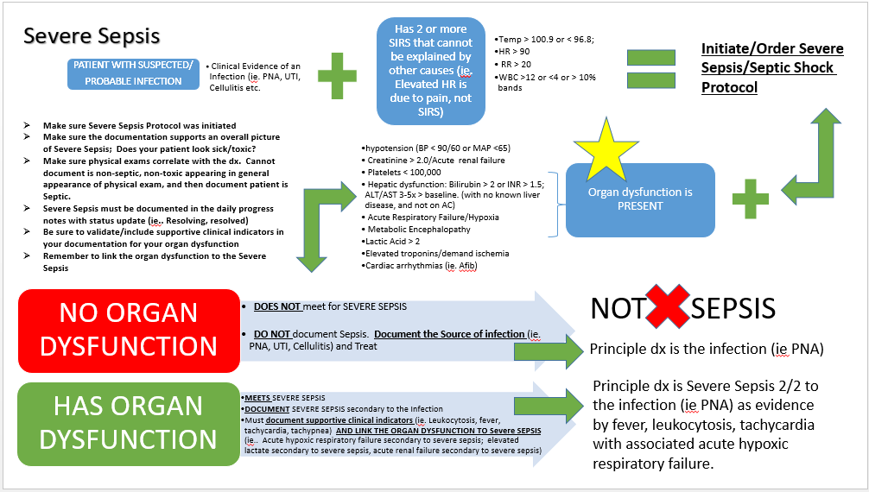
Tip Sheet
Notes:
So this tipsheet follows our Severe Sepsis Protocol that was developed by Dr. Kevin Shiley and our Quality Department in response to the Surviving Sepsis Campaign. Every hospital in NY state had to develop and implement a Sepsis Care Improvement Initiative, and this is what Catholic Health Established. Early identification and early targeted interventions for Severe Sepsis saves lives. Our System Wide Definition establishes that in order to treat and document on a Septic patient, this patient must have: 2 or more SIRS, a known or suspected infection AND an organ dysfunction that can be directly linked to the Sepsis.. If the patient does not have an organ dysfunction present, then the patient does not meet the criteria for Sepsis and only the Source of Infection is to be documented.

Slide 9
Conclusion/Take home points
Organ Dysfunction NEEDS to be present in order to document a Severe Sepsis diagnosis.
“Sepsis” or 2 SIRS and a source of infection should NOT be documented. Instead just document the infection itself (ie. Pneumonia).
Organ dysfunction needs to be linked to the Severe Sepsis in the documentation as a statement.
Severe Sepsis should be supported with appropriate physical exam findings. Does your physical exam reflect a patient who is “ill/toxic appearing” etc. Be cautious when utilizing Cut and Paste – do not carry forward inaccurate or old information.
Consistent documentation of Severe Sepsis is vital in the daily progress notes (ongoing, resolving, resolved) and must be carried through in to the DC Summary as a Discharge Diagnosis

