Slide 1

Acute Kidney Injury
CDI review

Slide 2
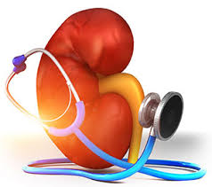

ACUTE RENAL FAILURE
Also known as Acute kidney injury
Codes to N17.9
Many Providers document “AKI”, however, this codes to “disorder of kidney and ureter, unspecified’’. Must be spelled out at least once in the medical record. If not, CDI and HIM must query the Physician for clarification of the abbreviation meaning.
Diagnostic criteria based on KDIGO

Slide 3

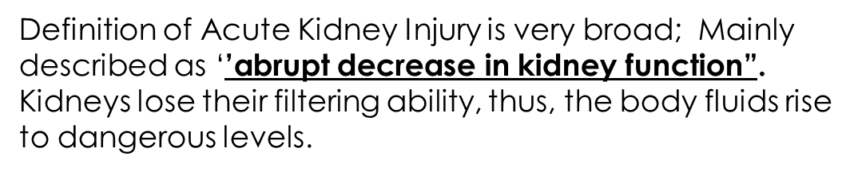
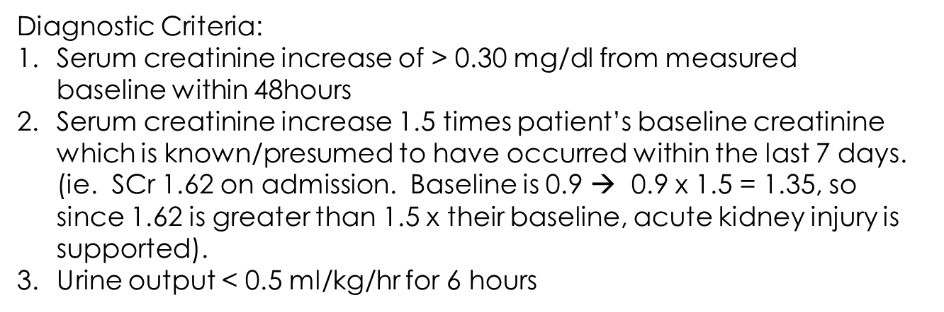
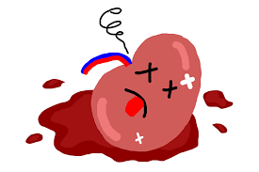
** If patient’s baseline creatinine is not known, KDIGO advises “the lowest SCr obtained during their hospital stay is usually equal to or greater than the baseline. This SCr should be used to diagnosis (and stage) acute kidney injury

Slide 4
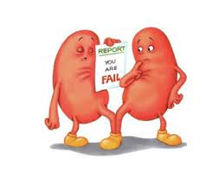
Examples of Acute Kidney Injury
Patient admitted for 5 days.. No past labs, or previous documentation of any type of renal disease. Received 2L IV fluid boluses in ED, and maintained on IVF NS @ 80ml/hr
Renal labs (Creatinine) trending as follows
Day 1: Creatinine 1.67 (at this time, we are unaware if this is patient’s normal)
Day 2: Creatinine 1.59
Day 3: Creatinine 1.30
Day 4: Creatinine 1.06
Day 5: Creatinine 0.96
Per KDIGO, the lowest SCr obtained during a hospital stay is usually equal to or greater than patient’s baseline.
In this case, we would use the 0.96 SCr as patient’s baseline (as it was the lowest one during his stay). 0.96 x 1.5 = 1.44
Since presenting SCr was 1.67, this is above 1.5x his baseline, thus supporting an acute kidney injury. This is considered RETROSPECTIVE validation as patient’s creatinine needed to be trended.
In discharge summary you would include Acute Kidney Injury, POA due to pre renal etiology, baseline Scr 0.96 with admitting Scr of 1.67 which is 1.5 x baseline

Slide 5
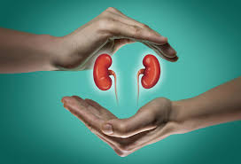
Examples of Acute Kidney Injury Con’t
When patient’s baseline creatinine is known:
Presents with creatinine of 2.89
Per H&P: Baseline creatinine of 1.14
How to Capture/Document this!!
H&P: Acute kidney injury
Baseline creatinine of 1.14; presented with SCr of 2.89 which is greater than 1.5 x his baseline
Be sure to include treatment of (ie.. IVF’s, holding ACEI/ARB etc)
Be sure to include in daily progress notes, and in DC Summary

Slide 6
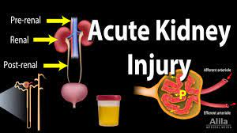

Please Document the Cause of Acute Kidney Injury
Pre-renal: blood flow to the kidneys is compromised causing renal hypoperfusion. (ie. Hemorrhage, dehydration, hypotension).
As long as corrected quickly, there is no actual damage to the kidneys
Most common cause of acute renal failure accounting for 60-70% of the cases
Most common condition leading to pre-renal AKI is dehydration. Other conditions leading to this are: Sepsis, Circulatory Shock (hypotension), Critical Illness
2. Intra-renal: damage within the kidneys causing cell death due to ischemia, infarction, necrosis, or disease
Most complicated form, as it is not simply corrected with IV fluids
Most common form is Acute tubular necrosis
Conditions leading to intra-renal causes: Medication toxicity (Vancomycin; Contrast Dye), Leukemia, Sarcoidosis, Hypertensive kidney disease, and diabetic nephropathy
Post-renal: Obstructive process that does not allow for proper excretion of waste from the kidneys.
Common Conditions: Bilateral Hydronephrosis, kidney stones, neoplasms, Obstructive uropathy/prostate hyperplasia; Patient’s with pelvic/abdominal tumors causing compression on the kidneys/ureters
Accounts for only 10% patient’s, therefore, is the rarest form
Treatment is reversal of the obstructive process (ie. Removal of kidney stone; insertion of stents to allow proper passage of urine into the bladder)

Slide 7

Diagnostic Criteria for ATN
Must meet Acute kidney Injury Criteria
(1.5 -2.0 increase in SCr from baseline)
Expected to take more than 72 hours for renal function (measured by SCr) to return near baseline following effective IV fluid resuscitation
Urine Na concentration > 40 meq/L (usually <20 in pre-renal AKI) and/or FENa (Fractional excretion of Na) > 2% (usually < 1% in pre-renal AKI) *Optional*

Slide 8
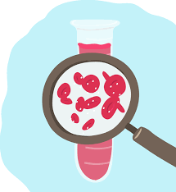
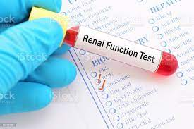

OPTIONAL DIAGNOSTIC CRITERIA FOR ATN
Urinalysis: muddy brown, granular, epithelial cells, casts and free renal tubular epithelial cells. ** Absence of these findings does not exclude ATN*
Fractional Excretion of sodium and urine sodium concentration
FENa, percent $=\frac{UNa x SCr }{SNa x UCr}$ x 100
Absence of these do not exclude ATN

Slide 9
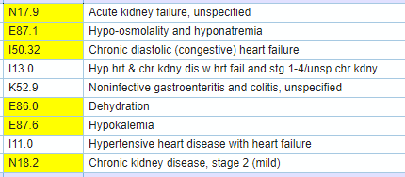
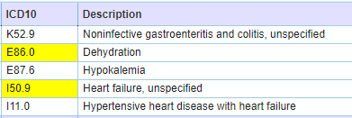
Acute Kidney Injury Case Example
Patient presented with 2 day history of nausea and diarrhea. Has known HFpEF, Baseline creatinine of 1.15 with GFR of 80, HTN
Labs on admission: K 3.1 Na 129 creatinine 1.89; Stool for C Diff sent.. resulted negative.
Per H&P and daily progress notes: Admitted for Dehydration and Gastroenteritis
GMLOS: 2.6 days
Reimbursement: $4,867.11
Provider missed acute kidney injury, hyponatremia and CKD 2 as diagnoses. Also added specificity in regards to HF.
Revised coding summary
GMLOS 3.1 days
Reimbursement: $5,655.13

Slide 10
In Conclusion
Include your diagnostic criteria for acute kidney injury in your documentation (1.5 x baseline, 0.30 mg/dl increase in 48hours, urine output < 0.5 ml/kg/hr for 6 hours)
Document baseline creatinine (as already known, take a look back in EPIC, or if need to trend during hospital stay- use lowest SCr)
Include the type of acute kidney injury (pre-renal, intrinsic, post renal)
Include underlying cause of acute kidney injury (renal hypoperfusion (hypotension, dehydration), Vanco toxicity, Contrast induced nephropathy, hydronephrosis/obstructive uropathy)
If ATN, make sure meets acute kidney injury criteria, that creatinine takes longer than 72 hours to start to trend back down; Obtain Renal Consult, and include cause and treatment in your documentation.
Be sure to carry the diagnosis in the daily progress notes throughout the patient’s stay, with updates, and include in the DC Summary listed diagnoses.

