Slide 1
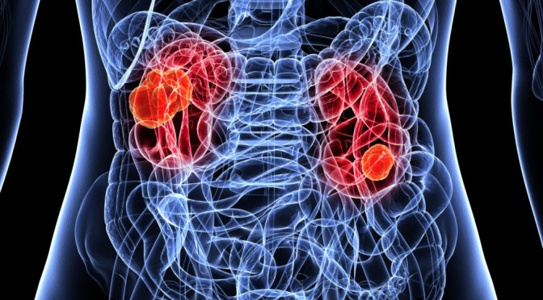
Acute Kidney Injury
Presented by CDI, HIM, and CDAD
September 2022

Slide 2
Recap
Acute kidney injury is one of Catholic Health’s top denied diagnosis.
A Denial is when the Insurance Company reviews the record and finds lack of clinical support, conflicting documentation, and/or lack of treatment for a diagnosis billed by the hospital organization; They then notify the Hospital Organization via mail that they are removing a diagnosis from the claim and explain their reasoning why.
An Organization can appeal the denial letter by sending a letter back to the Insurance Carrier explaining their reasoning for maintaining the diagnosis on the claim. This letter includes actual clinical support from the medical record and cited references from CMS and/or World Health Organizations to add additional support to the diagnosis.
If the Organization is unable to locate/provide the clinical support for the denied diagnosis from the documentation in the medical record, they will not appeal the denied diagnosis and it is removed from the claim. This leads to the Hospital Organization having to reimburse the Insurance Carrier, and it can potentially lower the patient’s SOI/ROM and intended LOS
CDI, HIM, and the Clinical Denials Team (CDAD) have teamed together, with the endorsement of Leadership, in order to create System Wide Education on Documentation requirements that will support the clinical validity of Acute Kidney Injury

Slide 3
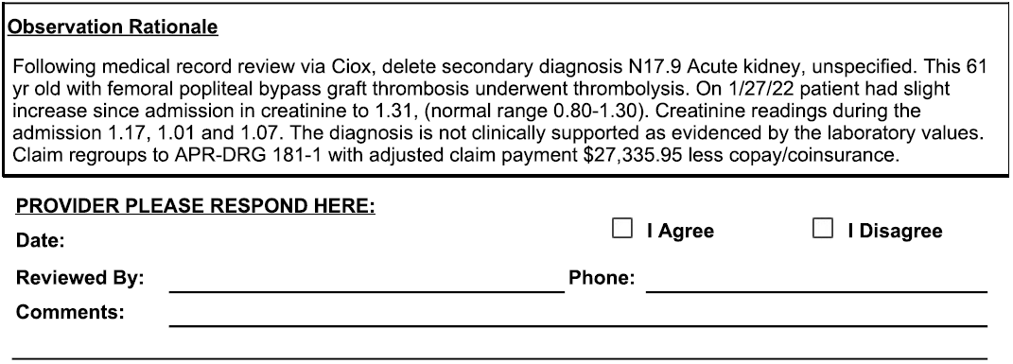
Example of Denial Letter for Acute Kidney Injury

Slide 4
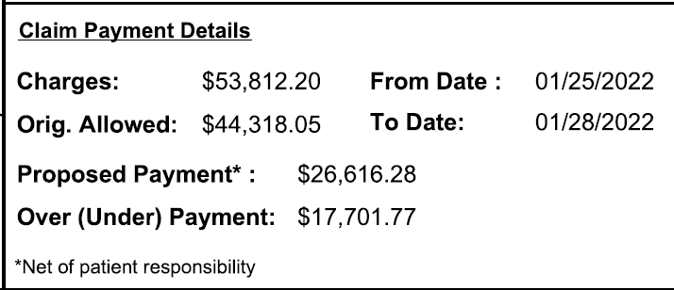
Patient’s Claim
Thus, the Insurance Carrier is asking for reimbursement of $17,701.77 to them citing the diagnosis
of Acute Kidney Injury was not supported during this patient’s admission.

Slide 5
Catholic Health Appealed!
Our Physician Advisor “disagreed” with the Insurance Carrier’s Reviewer
Physician Advisor cited “According to the National Kidney Foundation there is an acute kidney injury if the increase in creatinine is greater or equal to 0.30 mg/dl. The patient’s baseline creatinine was 1.01 and it went to 1.31 before coming down. This was a rise of 0.30 mg/dl. Therefore, this case meets the definition of acute kidney injury set by the National Kidney Foundation”.
Per the clinical documentation in the medical record:
  Patient underwent catheter directed thrombolysis with EKOS and TPA followed by RLE Angiogram with balloon angioplasty and mechanical thrombectomy. Postoperatively, patient was hypotensive with SBP in the 70’s and home antihypertensives were held.
  Trended Creatinine’s: 1.17… 1.01… 1.31… 1.07
  1/27 Medical Progress note: Acute Kidney Injury. Trend renal indices; Slight increase in creatinine since admission; NS at 40ml/hr started for hydration (Consistent documentation of condition and treatment)
Clinical Denials Team Cited: KDIGO defines Acute kidney injury as any of the following:
  Increase in creatinine level to ≥ 1.5x baseline (historical or measured), which is known or presumed to have occurred within the prior 7 days; or
  Increase creatinine (measured prospectively) of ≥ 0.3 mg/dl from baseline within 48 hours; or
  Urine output < 0.5 ml/kg/hr for 6 hours
These criteria apply to patients with and without CKD.

Slide 6
Catholic Health Appeal Con’t
Clinical Denials team also cited:
  The diagnosis of AKI depends on what the normal baseline for an individual patient is, not the reference range for the test (often misunderstood as "normal range") on the lab report. Reference range is a population-based statistic. It does not indicate what is normal for an individual. The AKI creatinine criteria are applied to the baseline without regard to the reference range.
EXAMPLES:
  Baseline = 0.4 mg/dl with increase to 0.8 mg/dl in 36 hrs meets both > 0.3 and 1.5x criteria (0.8 is 2x baseline of 0.4 = a substantial 50% loss of kidney function for this individual).
  Creatinine on admission = 1.0 with decrease to 0.5 (baseline) over two days meets 1.5x criterion (1.0 is 2x baseline of 0.5).
Pinson MD, R., & Tang , C. (n.d.). Acute Kidney Injury (AKI). Retrieved from CDI Pocket Guide: https://www.pinsonandtang.com

Slide 7
Response to Catholic Health’s Appeal
We are in receipt of your reconsideration request of the Reimbursement Integrity Unit’s determination to delete
secondary diagnosis N17.9 Acute kidney failure, unspecified.
Following a review of the documentation you submitted, along with a thorough re-review of the inpatient medical
record, Highmark Blue Cross Blue Shield of Western New York's original determination is being reversed.
This 61 year old with femoral popliteal bypass graft thrombosis, underwent thrombolysis. On admission creatinine
level 1.17/1.01/1.31 and on discharge 1.07. Acute kidney injury was documented and treated. According to
KDIGO guidelines there was an increase in serum creatinine level of >0.3mg/dl from baseline within 48 hours.
Secondary diagnosis N17.9 was correctly coded and will be included in the DRG calculation and the claim will
remain processed as APR-DRG 181-2. Thank you for your concern regarding this matter.
Therefore, Catholic Health maintains original DRG reimbursement (does not have to repay
Insurance Carrier), and SOI/ROM, and patient’s LOS stay unchanged

Slide 8
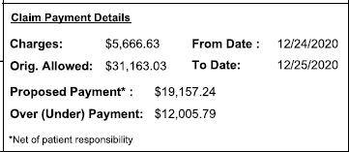
Acute Kidney Injury – No appeal as documentation did not support the diagnosis
Upon Catholic Health’s review of patient’s record:
No baseline creatinine documented by Provider
Admitting SCr 1.45 (was 1.55 one year prior)
H&P- Acute renal insufficiency secondary to dehydration; LOS Day 1 PN- Acute renal insufficiency secondary to dehydration.
Hospitalized 12/24 – 12/25
Did receive some IVF’s in the ED
Only place acute kidney injury was documented was in the DC Summary.
SCr 1.30 prior to discharge
** Catholic Health Reimbursed
Insurance Company

Slide 9
We Are Here to Help You!
CDI Specialists
CODING Specialists
CLINICAL DENIALS
Specialists (CDAD)
Review the medical record and all documentation while patient is in the hospital.
Place queries/talk with the Provider to obtain clarification, more specific documentation and to alert Provider of conflicting and/or inaccurate documentation.
Goal is to obtain a complete and accurate record before the patient is discharged.
Review the medical record and all documentation after the patient is discharged.
Final codes record and sends to billing department for final claim to the Insurance Carrier.
Also query if there is inaccurate, conflicting documentation or if further clarification is needed in the medical record.
Goal is to obtain a complete and accurate record.
Review the closed records documentation after the Insurance Carrier has denied a diagnosis.
Team up with the Physician Advisor to effectively determine medical necessity, to locate and identify crucial medical record documentation in order to support the denied diagnosis and Appeal to the Insurance Carrier.

Slide 10
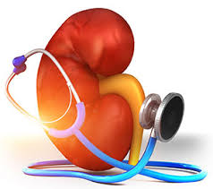

ACUTE RENAL FAILURE
Also known as Acute kidney injury
Codes to N17.9
Many Providers document “AKI”, however, this codes to “disorder of kidney and ureter, unspecified’’. Must be spelled out at least once in the medical record. If not, CDI and HIM must query the Physician for clarification of the abbreviation meaning.
Diagnostic criteria based on KDIGO

Slide 11

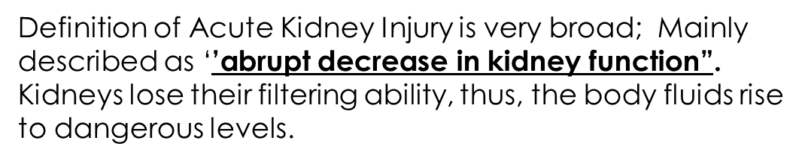
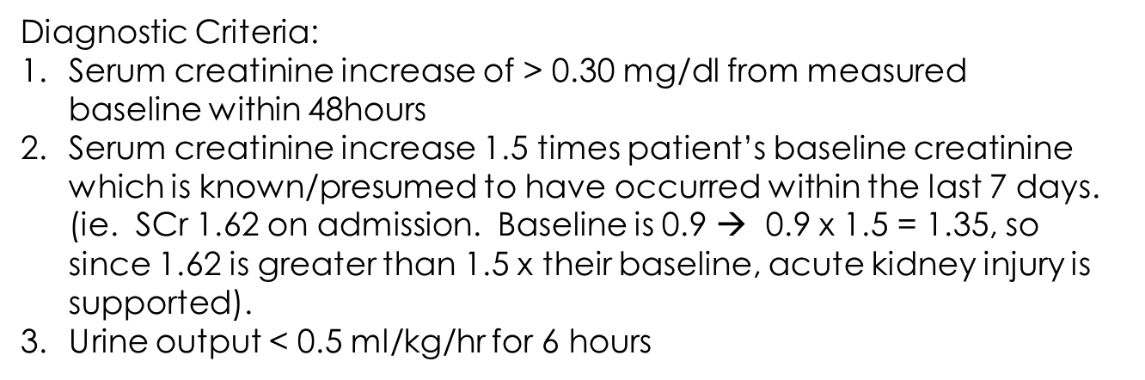
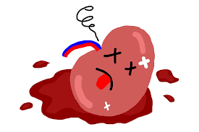
** If patient’s baseline creatinine is not known, KDIGO advises “the lowest SCr obtained during their hospital stay is usually equal to or greater than the baseline. This SCr should be used to diagnosis (and stage) acute kidney injury

Slide 12
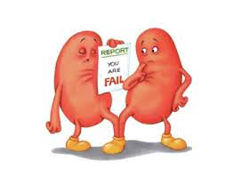
Examples of Acute Kidney Injury
Patient admitted for 5 days.. No past labs, or previous documentation of any type of renal disease. Received 2L IV fluid boluses in ED, and maintained on IVF NS @ 80ml/hr
Renal labs (Creatinine) trending as follows
  Day 1: Creatinine 1.67 (at this time, we are unaware if this is patient’s normal)
  Day 2: Creatinine 1.59
  Day 3: Creatinine 1.30
  Day 4: Creatinine 1.06
  Day 5: Creatinine 0.96
Per KIDIGO, the lowest SCr obtained during a hospital stay is usually equal to or greater than patient’s baseline.
In this case, we would use the 0.96 SCr as patient’s baseline (as it was the lowest one during his stay). 0.96 x 1.5 = 1.44
Since presenting SCr was 1.67, this is above 1.5x his baseline, thus supporting an acute kidney injury. This is considered RETROSPECTIVE validation as patient’s creatinine needed to be trended.

Slide 13

How to Document/Capture this!!
In the H&P: Elevated Creatinine.. No known baseline. Trend renal labs/creatinine. Maintain IVF’s at 80ml/hr. (if on nephrotoxic medications, these are usually held)
Progress notes Day 1-3: Elevated creatinine; Creatinine trending down, remains on IVF’s at 80ml/hr
Progress note Day 4: Creatinine down to 1.06 today, Suspecting an acute kidney injury on admission. Will continue IVF resuscitation.
Day 5 DC Summary: Acute kidney injury; Lowest SCr 0.96, Presented with SCr of 1.67 which is greater than 1.5x patient’s baseline of 0.96. Was maintained on IV Fluids

Slide 14
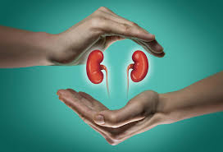
Examples of Acute Kidney Injury Con’t
When patient’s baseline creatinine is known:
  Presents with creatinine of 2.89
  Per H&P: Baseline creatinine of 1.14
How to Capture/Document this!!
H&P: Acute kidney injury
    Baseline creatinine of 1.14; presented with SCr of 2.89 which is greater than 1.5 x his baseline
    Be sure to include treatment of (ie.. IVF’s, holding ACEI/ARB etc)
    Be sure to include in daily progress notes, and in DC Summary

Slide 15

Examples of Acute Kidney Injury Con’t
Prospective Validation (the > 0.3 mg/dL criteria)
  Patient comes in with normal/baseline creatinine
  48 hours or later, patient’s SCr must show an increase of at least 0.30 mg/dL (this increase MUST be observed between the 2 values
  ie. Patient admitted with Acute Systolic CHF; Treating with 40mg IV Lasix twice daily. SCr is 1.5 on admission and on day 2, SCr increases to 2.06 (this is a 0.56 mg/dl increase from presenting creatinine)
  Treatment of acute kidney injury is initiated (IVF’s, avoidance of nephrotoxic medications).. Usually takes at least another 48hours to see the patient’s SCr trend back down to where it was at the time of admission.
How to Capture/Document this!!
Progress Note Day 2: Acute kidney Injury: SCr increase of greater than 0.30 mg/dl. Suspect due to Lasix therapy.
Be sure to include treatment and contraindications to treatment
  Discontinue Lasix, Change to Bumex 2mg po daily.. No IVFs due to being in acute CHF.
  Be sure to document acute kidney injury in proceeding progress notes, and in DC Summary with update in status (improving, worsening, resolved).

Slide 16
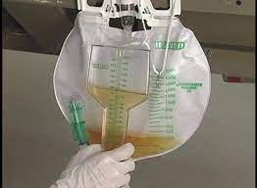
Examples of Acute Kidney Injury Con’t
Urine Output Criteria – MUST PROVE urine output is <0.5 ml/kg/hr for at least 6 hours
Example: 68 kg male patient produces 200ml of urine over 7 hours
  200/68 = 2.94 ml/kg; then 2.94/7 (hours) = 0.42 ml/kg/hr
These patient’s usually have “oliguria” documented; have foley catheters with urometer for measurement of hourly urine outputs. Their clinical picture usually reveals: listlessness, confusion, fatigue, N/V, anorexia
Thus, these are usually ICU patients
Documentation!!
In progress notes: acute kidney injury; patient oliguric, output 200 ml over last 7 hours. Provide clinical picture as applicable: is your patient suffering from listlessness, confusion, fatigue, anorexia etc.
Include treatment: Hourly urine, accurate I&O’s, IVF’s, avoidance of nephrotoxic medications.
Be sure to document on daily, and in the DC Summary

Slide 17
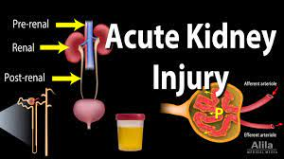

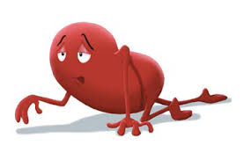
Please Document the Cause of Acute Kidney Injury
Pre-renal: blood flow to the kidneys is compromised causing renal hypoperfusion. (ie. Hemorrhage, dehydration, hypotension).
  As long as corrected quickly, there is no actual damage to the kidneys
  Most common cause of acute renal failure accounting for 60-70% of the cases
  Most common condition leading to pre-renal AKI is dehydration. Other conditions leading to this are: Sepsis, Circulatory Shock (hypotension), Critical Illness
2. Intra-renal: damage within the kidneys causing cell death due to ischemia, infarction, necrosis, or disease
  Most complicated form, as it is not simply corrected with IV fluids
  Most common form is Acute tubular necrosis
  Conditions leading to intra-renal causes: Medication toxicity (Vancomycin; Contrast Dye), Leukemia, Sarcoidosis, Hypertensive kidney disease, and diabetic nephropathy

Slide 18
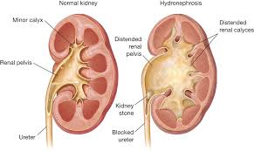

Types of Renal Failure Con’t
Post-renal: Obstructive process that does not allow for proper excretion of waste from the kidneys.
  Common Conditions: Bilateral Hydronephrosis, kidney stones, neoplasms, Obstructive uropathy/prostate hyperplasia; Patient’s with pelvic/abdominal tumors causing compression on the kidneys/ureters
  Accounts for only 10% patient’s, therefore, is the rarest form
  Treatment is reversal of the obstructive process (ie. Removal of kidney stone; insertion of stents to allow proper passage of urine into the bladder)
  If not corrected quickly, can lead to direct damage of the kidneys

Slide 19

Diagnostic Criteria for ATN
Must meet Acute kidney Injury Criteria
(1.5 -2.0 increase in SCr from baseline)
Expected to take more than 72 hours for renal function (measured by SCr) to return near baseline following effective IV fluid resuscitation
Urine Na concentration > 40 meq/L (usually <20 in pre-renal AKI) and/or FENa (Fractional excretion of Na) > 2% (usually < 1% in pre-renal AKI) *Optional*

Slide 20

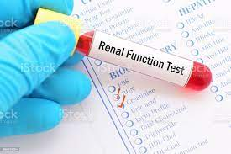

OPTIONAL DIAGNOSTIC CRITERIA FOR ATN
Urinalysis: muddy brown, granular, epithelial cells, casts and free renal tubular epithelial cells. ** Absence of these findings does not exclude ATN*
Fractional Excretion of sodium and urine sodium concentration
FENa, percent $=\frac{UNa x SCr }{SNa x UCr}$ x 100
Absence of these do not exclude ATN

Slide 21
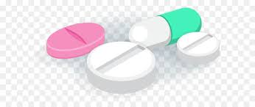
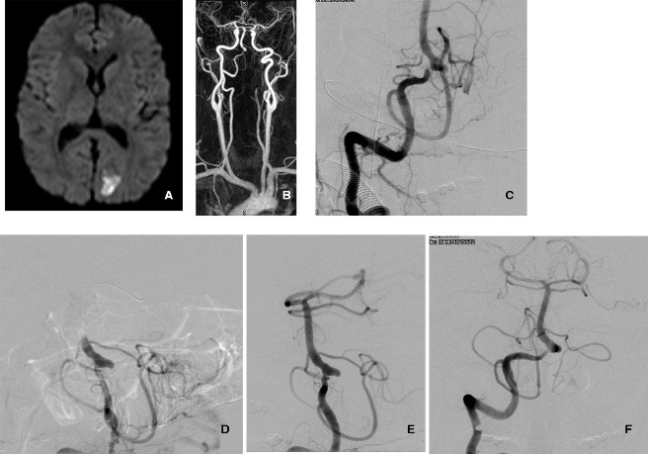
Please document underlying cause of ATN
Causes of ATN
IV CONTRAST
Medications
Prolonged hypotension
Prolonged pre-renal AKI
Rhabdo-myolosis
Tumor necrosis syndrome

Slide 22
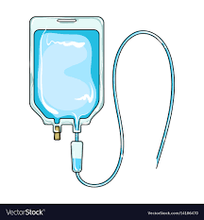
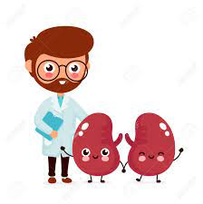
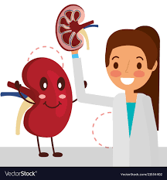

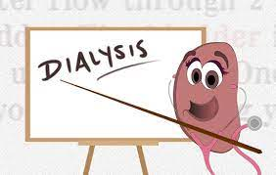
Treatment of ATN
NEPHROLOGY CONSULTATION
IV Fluid Resuscitation& Monitoring creatinine levels
Sometimes the addition of IV Lasix/Bumex
Correction of any causes; Maintain hemodynamics and proper electrolyte management
Avoiding Nephro-toxic agents & sometimes in need of Hemodialysis

Slide 23
In Conclusion
Include your diagnostic criteria for acute kidney injury in your documentation (1.5 x baseline, 0.30 mg/dl increase in 48hours, urine output < 0.5 ml/kg/hr for 6 hours)
Document baseline creatinine (as already known, take a look back in EPIC, or if need to trend during hospital stay- use lowest SCr)
Include the type of acute kidney injury (pre-renal, intrinsic, post renal)
Include underlying cause of acute kidney injury (renal hypoperfusion (hypotension, dehydration), Vanco toxicity, Contrast induced nephropathy, hydronephrosis/obstructive uropathy)
If ATN, make sure meets acute kidney injury criteria, that creatinine takes longer than 72 hours to start to trend back down; Obtain Renal Consult, and include cause and treatment in your documentation.
Be sure to carry the diagnosis in the daily progress notes throughout the patient’s stay, with updates, and include in the DC Summary listed diagnoses.

Slide 24
Please feel free to contact us with Questions
Clinical Documentation Integrity(CDI)
Deborah Mazur– Manager, Clinical Documentation Integrity
Office #: (716) 601-3752
Email: dmazur@chsbuffalo.org
Coding Education Quality Auditing
Justine Whitman – Manager, Coding Education Quality Auditing Inpatient
Office #: (716) 447-6581
Email: Jnolder@chsbuffalo.org
Clinical Denials and Appeals Department (CDAD)
Brandon Schulz-Koller – Director, Documentation Cycle Integrity and Improvement
Office #: (716) 601-3602
Email: bkoller@chsbuffalo.org

