Slide 1
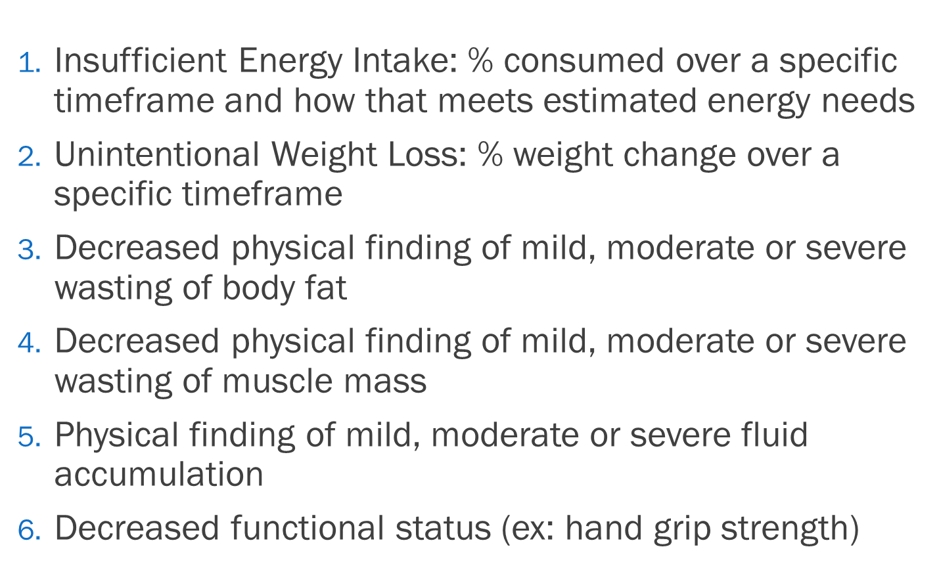
Malnutrition
Identifying malnutrition criteria
ASPEN 2012
Treatments/Interventions
Response to treatment
Nutritional supplements 2-3 times per day
Daily weights and calorie counts
Appetite stimulant
Monitor labs including electrolytes, phosphate and potassium
Parenteral or Enteral nutrition
Compliance with nutritional supplement
Weight stable
Labs stable/improving
Response to appetite stimulant
Plan continues at discharge
Ensure the treatment plan is as intense as the diagnosis is severe
Provider Note Must Include:
Incomplete Progress Note: Example
The Malnutrition Diagnosis documented by the Provider and added to the Problem list
Include the supportive clinical indicators from RD Clinical Assessment (at least 2)
Include plan for treatment and response to treatment
Continue/Include documentation into the discharge summary
Include post-discharge treatment (ie.. Patient is to continue with nutritional supplement 2x day)
What is missing from
progress note?
Severe protein calorie malnutrition, weight loss with concern for GI Malignancy
- Nutritional evaluation noted and appreciated, we are advancing her diet, monitor for tolerance.
- GI Following
Complete Progress Note: Example
** Did you document in your assessment “Well developed and well nourished?” If you did, documentation is inconsistent and needs to be addressed. Make sure physical exam correlates with a malnourished patient.

