Slide 1

Clinical Documentation Integrity
Jeffrey Lach, DO, FACP

Slide 2
Who are the CDI team and what do they do
Registered Nurses
Comprehensive concurrent review of records
Medical record accurately reflects severity of illness and risk of mortality
Communication via a question or query which is placed in Epic
Queries can ask for
Clarification in regards to a diagnosis (ruled in or ruled out)
Specification of a diagnosis (acute on chronic)
Clinical validation (SIRS criteria for sepsis diagnosis)

Slide 3
Query Types
Concurrent
Initiated by CDI RN
Real time
Retrospective
Initiated by coder
After discharge

Slide 4
Query Response
Progress Notes
Discharge Summary
Addendum
NOT in the Query directly
Everyone is responsible

Slide 5
Principal Diagnosis
Condition chiefly responsible for occasioning the admission
Everyone is responsible this
Should be updated as work up reveals more data

Slide 6
Signs & Symptoms
Are NOT to be used as PDx
Examples:
Chest pain
Abdominal pain
Syncope
N/V/diarrhea

Slide 7
Secondary Conditions Are:
Additional conditions that affect patient care in terms of requiring clinical evaluation, therapeutic treatment, diagnostic procedures while the patient is in the hospital
These conditions are referred to as “major co morbid conditions”(MCC) or “co morbid conditions” (CC)

Slide 8
Secondary Conditions
MCC: Major complication or comorbidity
CC: minor complication or comorbidity
both of the above affects DRG codes
These conditions increase the use of medical / hospital expenses and in turn increase hospital reimbursement

Slide 9
Examples of MCCs
Cerebral edema
Acute respiratory failure
Pneumonia
ARF with ATN
Acute systolic/diastolic CHF
ESRD
Severe Protein Calorie malnutrition

Slide 10
Examples of CCs
Hemiparesis/hemiplegia
Pleural effusion
Chronic respiratory failure
Acute renal failure
Acute blood loss anemia
Cellulitis
CKD, stage 4 or 5
Ascites
Moderate Protein Calorie Malnutrition

Slide 11
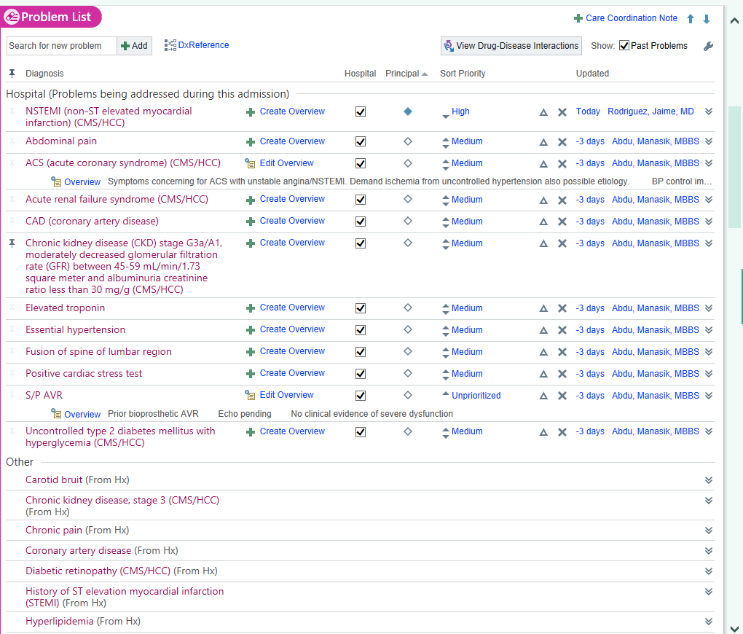

Slide 12
Impact of MCCs and CCs on a Neurosurgery DRG
MS-DRG 20 Intracranial Vascular Procedures With A PDX of Hemorrhagic
(with a major co morbid condition)
Coma
-Weight
7.7073
V24 DRG
Intracranial Vascular Procedures
DRG 528
Weight 7.0543
MS-DRG 22 Intracranial Vascular Procedures With A PDX of Hemorrhagic
(without a major co morbid condition or co morbid condition)
-Weight
5.6085

Slide 13
Case Review
Patient presents with 1 week of increasing SOB and wheezing. Has PMH of COPD with chronic O2 use (2L), history of chronic heart failure with reduced EF, CKD3b and diabetes
On exam patient with wheezing and fine crakes at bases of lungs, no evidence of respiratory distress on home O2 of 2L , + JVD and 3+ pitting edema in legs
Labs: creatinine at baseline 1.83, glucoses are elevated at over 200+ , magnesium is 1.2 and potassium is 2.9

Slide 14
Documentation Impact
Baseline
COPD Flare
CHF exacerbation
HTN
Final after CDI team review
Acute exacerbation of COPD
Chronic hypoxic respiratory failure
Acute on chronic systolic heart failure
CKD stage IIIb
Hypomagnesemia
Hypokalemia
HTN

Slide 15
Documentation Impact
Baseline
GMLOS: 2.4 days
Weight: 0.6956
Reimbursement: $ 4, 395.69
Final after CDI team review
GMLOS 3.6 days
Weight: 1.1251
Reimbursement: $8,709.83

Slide 16
Closing Remarks
CDI is a team effort
When you read a chart does it accurately reflect how the patient appears and the intensity of work up and treatment received

