Slide 1
Evaluation and Management of Syncope
Anne B. Curtis, MD, MACP, FACC, FHRS, FAHA
Charles and Mary Bauer Professor and Chair
Department of Medicine
Jacobs School of Medicine & Biological Sciences
University at Buffalo
Buffalo, NY, USA

Slide 2
Disclosures
Abbott: honoraria for speaking; advisory board
Medtronic, Inc.: honoraria for speaking; data monitoring board
Sanofi Aventis: advisory board
Janssen Pharmaceuticals: advisory board
Milestone Pharmaceuticals: advisory board
Zoll: honoraria for speaking

Slide 3

Syncope: Definition
A syndrome in which loss of consciousness is:
  relatively sudden onset
  temporary (usually <1-2 min)
  self-terminating
  usually rapid recovery
Due to inadequate cerebral perfusion
Most often due to a fall in systemic arterial pressure
Notes:
Transient Loss of Consciousness, or TLOC, is just that—as is illustrated here.
It can be as simple as a benign ‘faint’ or a symptom of an underlying disease that may lead to sudden death. Or it may not be syncope at all.

Slide 4
Causes of Syncope
Cardiovascular Causes
Neurally-
Mediated
Reflex
Orthostatic
Cardiac
Arrhythmia
Structural
Cardio-
Pulmonary
VVS
CSS
• Situational
  Cough
  Post-
  micturition
Drug-Induced
• ANS Failure
  Primary
  Secondary
Aortic Stenosis
HCM
Pulmonary Hypertension
Pulmonary
Embolism
Aortic Dissection
Bradycardia
  Sinus pause/arrest
  AV block
• Tachycardia
  VT, SVT
  LQTS, Brugada, etc.
60%
15%
10%
5%
Unexplained Causes ≈10%
Moya A et al, ESC Syncope Guidelines, Eur Heart J 2009; 30: 2642
Notes:
This slide provides a simple classification of the principal causes of syncope. This scheme lists the causes of syncope from the most commonly observed (Left) to the least common (Right). This ranking may be helpful in thinking about the strategy for evaluating syncope in individual patients.
Within the boxes,the most common causes of syncope are indicated for each of the major diagnostic groups.
VVS—Vasovagal Syncope
CSS—Carotid Sinus Syndrome
ANS—Autonomic Nervous System
HCM—Hypertrophic Cardiomyopathy

Slide 5
2017 ACC/AHA/HRS Guideline for the Evaluation and
Management of Patients With Syncope
Shen W et al., Heart Rhythm 2017;14:e155-e217

Slide 6
General Principles
Syncope Initial Evaluation

Slide 7
Basic Diagnostic Strategy
The Initial Evaluation
  History, physical exam (orthostatic blood pressure), ECG
Risk Assessment
  In-hospital vs out-of-hospital diagnostic evaluation
Selected Subsequent Testing
  Ambulatory:
    ECG Monitoring (external loop recorder, mobile outpatient cardiac telemetry (MCOT), insertable loop recorder)
  Hospital-based:
    Hemodynamics/angiography, stress testing, electrophysiologic study, tilt table

Slide 8

Initial Evaluation
Essentials of the History
Concomitant disease, especially cardiac
  Medication history
Pertinent family history
  Cardiac disease, Unexpected death
Past medical history
  Heart disease (structural, arrhythmia)
  Metabolic and neurologic disease
Circumstances of recent event(s)
  Eyewitness account of event
  Warning symptoms
  Consider unexplained ‘falls’ (possible amnesia in elderly)
Notes:
The history must include detailed summary of events leading up to and following syncope events. Additionally, it is important to ascertain whether there is any evidence of underlying structural heart disease. The direction of subsequent evaluation differs in patients with and without heart disease.

Slide 9
Initial Examination
Essentials of Physical Examination
Vital signs
  Collapsed (rarely obtained) vs. post-recovery
  Heart rate, regularity, murmurs, left ventricular hypertrophy
  Orthostatic blood pressure change
CV Exam: heart or vascular disease?
Carotid sinus massage
  Perform upright position or during tilt-table test
  Monitor beat-to-beat blood pressure
Neurological exam
  Residual and/or new deficits?

Slide 10
Features Suggesting Cause of Syncope
Reflex (neurally-mediated)
  Absence of cardiac disease
  Long history with multiple recurrences
  Triggers including:
    Pain, hot environment, head rotation
    Prolonged standing, volume depletion, after strenuous exertion
Orthostatic
  After move to upright posture, may be exacerbated by:
    Volume depletion, diuretics, vasodilators, etc
    History of neuropathy, diabetes, alcohol abuse
Cardiac/Cardiovascular
  Structural heart disease/major ECG abnormality:
    Including: prior myocardial infarction, hypertrophic cardiomyopathy, arrhythmogenic right ventricular cardiomyopathy, acute ischemia, AV block, channelopathy, preexcitation, etc.
  Family history of sudden death
  Occurrence during exercise or supine
Moya A et al, ESC Syncope Guidelines, Eur Heart J 2009; 30: 2631-71
Notes:
The history must include detailed summary of events leading up to and following syncope events. Additionally, it is important to ascertain whether there is any evidence of underlying structural heart disease. The direction of subsequent evaluation differs in patients with and without heart disease.

Slide 11
Clinical Findings Strongly Favoring
In-Hospital Diagnostic Testing
Suspected/known clinically significant heart disease
ECG abnormalities suggesting potential life-threatening arrhythmic cause
Syncope during exercise or while supine
Severe injury/accident
Family history of premature sudden death
Moya A et al, ESC Syncope Guidelines, Eur Heart J 2009; 30: 2631-71

Slide 12
Disposition After Initial Evaluation
COR | LOE | Recommendations
I | B-NR | Hospital evaluation and treatment are recommended for patients presenting with syncope who have a serious medical condition potentially relevant to the cause of syncope identified during initial evaluation.
IIa | C-LD | It is reasonable to manage patients with presumptive reflex-mediated syncope in the outpatient setting in the absence of serious medical conditions.
IIa | B-R | In intermediate-risk patients with an unclear cause of syncope, use of a structured ED observation protocol can be effective in reducing hospital admission.
IIb | C-LD | It may be reasonable to manage selected patients with suspected cardiac syncope in the outpatient setting in the absence of serious medical condition.

Slide 13
Patient Disposition After Initial Evaluation for Syncope
ED indicates emergency department; pts, patients.

Slide 14
Additional Evaluation and Diagnosis
Colors correspond to Class of Recommendation.
*Applies to patients after a normal initial evaluation without significant injury or cardiovascular morbidities; patients followed up by primary care physician as needed.
†In selected patients (see Section 1.4).
CT indicates computed tomography; CV, cardiovascular; ECG, electrocardiogram; EPS, electrophysiological study; MRI, magnetic resonance imaging; OH, orthostatic hypotension; and TTE, transthoracic echocardiography.

Slide 15
Blood Testing
COR | LOE | Recommendations
IIa | B-NR | Targeted blood tests are reasonable in the evaluation of selected patients with syncope identified on the basis of clinical assessment from history, physical examination, and ECG.
IIb | C-LD | Usefulness of brain natriuretic peptide and high-sensitivity troponin measurement is uncertain in patients for whom a cardiac cause of syncope is suspected.
III: No Benefit | B-R | Routine and comprehensive laboratory testing is not useful in the evaluation of patients with syncope.

Slide 16
Cardiovascular Testing
Cardiac Imaging
COR | LOE | Recommendations
IIa | B-NR | Transthoracic echocardiography can be useful in selected patients presenting with syncope if structural heart disease is suspected.
IIb | B-NR | CT or MRI may be useful in selected patients presenting with syncope of suspected cardiac etiology.
III: No Benefit | B-R | Routine cardiac imaging is not useful in the evaluation of patients with syncope unless cardiac etiology is suspected on the basis of an initial evaluation, including history, physical examination, or ECG.

Slide 17
Stress Testing
COR | LOE | Recommendation
IIa | C-LD | Exercise stress testing can be useful to establish the cause of syncope in selected patients who experience syncope or presyncope during exertion.

Slide 18
Cardiac Monitoring
COR | LOE | Recommendations
I | C-EO | The choice of a specific cardiac monitor should be determined on the basis of the frequency and nature of syncope events.
IIa | B-NR | To evaluate selected ambulatory patients with syncope of suspected arrhythmic etiology, the following external cardiac monitoring approaches can be useful: 1. Holter monitor 2. Transtelephonic monitor 3. External loop recorder 4. Patch recorder 5. Mobile cardiac outpatient telemetry.
IIa | B-R | To evaluate selected ambulatory patients with syncope of suspected arrhythmic etiology, an ICM can be useful.

Slide 19
In-Hospital Telemetry
COR | LOE | Recommendation
I | B-NR | Continuous ECG monitoring is useful for hospitalized patients admitted for syncope evaluation with suspected cardiac etiology.

Slide 20
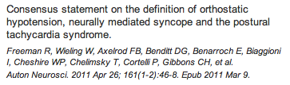
Postural Blood Pressure Testing for Orthostatic Hypotension
  Sustained BP drop usually within 3-5 min standing or HUT to ≥60°
    Systolic BP fall ≥20 mmHg, or
    Diastolic BP fall ≥10 mmHg
In hypertensive patients
    Systolic BP fall of ≥30 mmHg
In some cases symptoms may be delayed 5-15 min

Slide 21
Carotid Sinus Massage (CSM)
Method
  Massage, ~10 seconds, firm but do not occlude
  Supine and upright posture (on tilt-table)
Suggests Carotid Sinus Syndrome (CSS) if:
  >6 sec asystole* or >50 mmHg fall in systolic BP
  Reproduction of symptoms (usually only occurs with CSM during upright posture)
  * Previously 3 sec was considered adequate, but longer pause is now recommended
Brignole M et al Europace 2011; 13: 462-64,
Krediet CTP et al Europace 2011;13: 14-22
Notes:
Carotid sinus massage (CSM) is an often overlooked, yet highly cost effective test, especially in older syncope patients. CSM must be applied with care, and the method described here has proven both safe and effective.
Note that an abnormal response to CSM (i.e., Carotid Sinus Hypersensitivity, CSH) is not diagnostic of Carotid Sinus Syndrome (CSS). Reproduction of symptoms is a crucial diagnostic element. To achieve symptom reproduction, it may be useful to conduct CSM with the patient in the upright posture. If the latter is to be done, the patient should be safely secured to a tilt-table in order to prevent injury from a fall.
Note: May perform during tilt-table test.
*Munro N, McIntosh S, Lawson J, et al. Incidence of complications after carotid sinus massage in older
patients with syncope. J Am Geriatr Soc. 1994;42:1248-1251.

Slide 22
Additional Diagnostic Tests
Use Based on Initial Examination and Risk Stratification
Ambulatory ECG
  Wearable external monitors
  Insertable loop recorder
Head-Up Tilt Test (with CSM)
Electrophysiology study (EPS)
Non-invasive for life-threatening VT/VF
  SAECG
  Heart rate variability, HR turbulence
  Microvolt T-wave alternans, QT dispersion

Slide 23
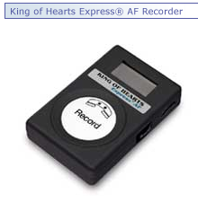
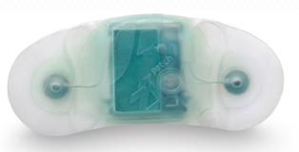
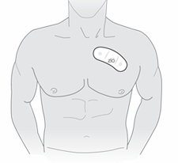
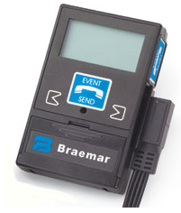
External ‘Loop’ Recorders (ELRs)
7-day ‘Patch’
ELR
Up to 1 month recording

Slide 24
ICM Devices

Slide 25
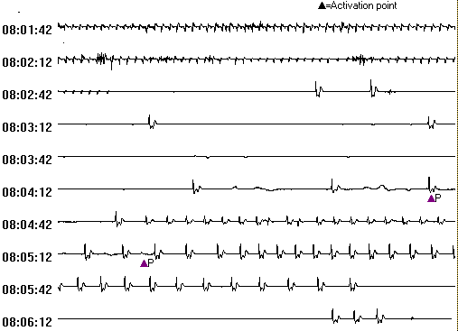
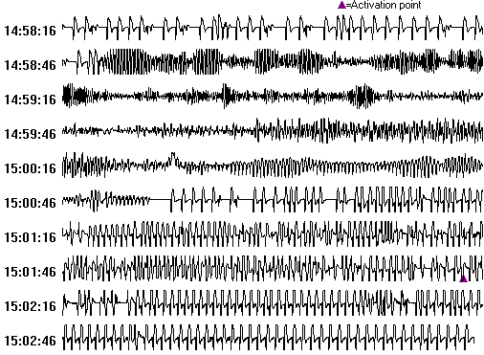

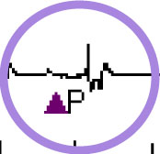

Symptom-Rhythm Correlation
ILR Syncope Cases with
Brady- and Tachyarrhythmias
56 year old woman with refractory syncope accompanied with ‘seizures
65 year old man with syncope accompanied by brief retrograde amnesia
Notes:
These are examples of ECG recordings obtained by the Reveal® ILR system in two symptomatic patients.
The gold standard for determining if a syncope episode is due to an arrhythmia is to record the rhythm during symptoms, ie, symptom-rhythm correlation. The ILR may help rule-in or rule-out arrhythmogenic causes.
These strips depict findings from an ILR interrogation as they appear on the programmer screen. In order to view the event in greater detail, one taps the screen over the ECG of interest.
On-screen calipers are available at every zoom level to measure cycle length in milliseconds or beats per minute.
Note that the ‘A’ represents an auto-activated event; the P indicates when the patient activated the device.
Upper strip: Infra-Hisian AV block: dual chamber pacemaker.
Lower strip: VT and VF: ICD, meds.

Slide 26
Evidence for ICMs in Syncope
Study/First Author (Year) (Ref. #) | Study Type | N | Results
RAST (2001) (30) | Randomized controlled trial | 60 | Diagnosis in 55% of patients in the ICM arm compared with 19% in the control (p = 0.0014)
PICTURE (2011) (31) | Multicenter prospective | 570 | ICMs assisted in diagnosis in 30% of patients
Solbiati et al. (2016) (18) | Systematic review | 579 | Patients with ICM implantation experienced higher rates of diagnosis (RR: 0.61; CI: 0.54–0.68)
Krahn et al. (2003) (32) | Randomized crossover study | 60 | ICM strategy was more expensive per participant but cost lower per diagnosis when compared with conventional testing
ISSUE-3 (2012) (33) | Randomized controlled trial | 511 | Risk of syncope recurrence in patients with ICM-detected syncope randomized to pacing arm was reduced by 57% (CI: 4%–81%)
SPRITELY (2018) (34) | Randomized pragmatic trial | 115 | Empirical pacemaker arm experienced lower rates of primary composite outcomes

Slide 27
Tilt-Table Testing
COR | LOE | Recommendations
IIa | B-R | If the diagnosis is unclear after initial evaluation, tilt-table testing can be useful for patients with suspected VVS.
IIa | B-NR | Tilt-table testing can be useful for patients with syncope and suspected delayed OH when initial evaluation is not diagnostic.
IIa | B-NR | Tilt-table testing is reasonable to distinguish convulsive syncope from epilepsy in selected patients.
IIa | B-NR | Tilt-table testing is reasonable to establish a diagnosis of pseudosyncope.
III: No Benefit | B-R | Tilt-table testing is not recommended to predict a response to medical treatments for VVS.

Slide 28
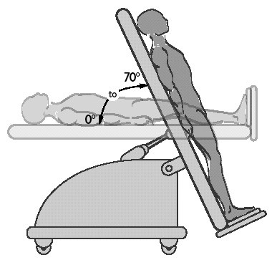
Head-Up Tilt Test (HUT)
Protocols vary
  some use provocative drugs
Goals
  Unmask VVS susceptibility
  Reproduce symptoms
  Patient learns VVS warning symptoms
  Patient more confident of diagnosis
Not recommended for predicting treatment benefit
Notes:
The rationale for undertaking head-up tilt (HUT) testing in patients suspected of having vasovagal (VVS) syncope is summarized here. In essence, the test may not only provide useful diagnostic information, but it also provides an opportunity for patients to become more familiar with the condition and its possible warning signs. The latter may prove to be of considerable diagnostic utility in many individuals.
Provocative drugs: isoproterenol vs. sublingual nitroglycerin—discuss pros and cons

Slide 29
VVS: Typical HUT Protocol
  Supine rest period 5-15 min
  Tilt to 60-70°for 20 min
  Positive end-point: syncope with reproduction of symptoms
  If negative, then add drug provocation while still upright
    Nitroglycerine 0.4mg SL, or
    Isoproterenol 1-5 mcg/min, to increase HR to 125% baseline
  Extend tilt after drug, duration 10-15 minutes
Moya A et al, ESC Syncope Guidelines,
Eur Heart J 2009; 30: 2631-71
Notes:
Diagnosing VVS
VVS is most effectively diagnosed if the detailed medical history is ‘classic’. However, this is not often the case, and supporting evidence is needed, Such supportive evidence may include:
Patient history, physical examination, ECG, and other tests provide no diagnosis for patient complaints of syncope.
Patient experiences syncope during head-up tilt-table testing. Test completion without syncope is a negative result.
The following HUT protocol is based on the ACC Consensus Document on tilt-table testing (Benditt 1996). Other accepted HUT protocols do exist.
Overnight fast, morning test
ECG (at least 3 leads)
Continuous blood pressure monitoring
Patient remains supine on the table for 15-30 minutes.
Tilt to 60-80 degrees for 20-45 minutes.
Lower to horizontal and administer isoproterenol at 1-5 μg/min until heart rate increases 25%.
Re-tilt for 10 minutes
REFERENCE:
Benditt DG, Ferguson DW, Grubb BP, et al. Tilt table testing for syncope. ACC Expert Consensus Document. JACC. 1996;28(1):263-275.

Slide 30
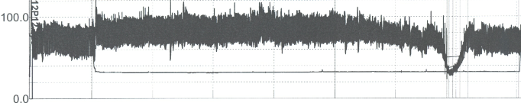
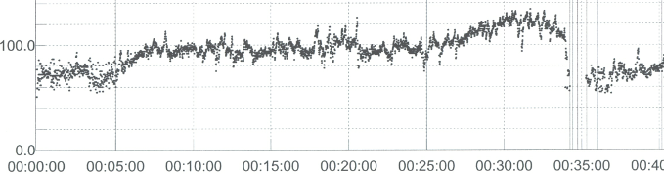
Vasovagal Syncope: Hypotension and Bradycardia Triggered by HUT
Courtesy R Sutton DSc
Notes:
Heart Rate monitor and Finapres® pressure tracing illustrating posture-induced vasovagal syncope. Note that the initial sinus tachycardia. Thereafter, blood pressure tended to fall in advance of the bradycardia component.

Slide 31
EP Testing for Syncope Evaluation
Principal Diagnostic Findings
Most useful in structural heart disease patients
Useful diagnostic observations:
  Inducible monomorphic VT
  SNRT > 3000 ms or CSNRT > 600 ms
  Inducible SVT with hypotension
  HV interval ≥ 100 ms (especially in absence of inducible VT)
  Pacing-induced infra-nodal block
Brignole M, et al. Europace, 2004;6:467-537
Notes:
Conventional EP testing (i.e. EPS, electrical stimulation without autonomic studies such as HUT) has not been highly effective in substantiating a basis for syncope. In this regard, EPS has been more effective in patients with structural cardiovascular disease than in those with normal cardiovascular status.
Brignole M, Alboni P, Benditt DG, et al. Guidelines on Management (Diagnosed Treatment) of Syncope-Update 2004. Europace. 2004;6:467-537.

Slide 32
Specific Conditions
Reflex (Neurally-mediated) Syncope (NMS)
  Vasovagal, Carotid Sinus Syndrome (CSS), etc.
Orthostatic Hypotension
  Autonomic dysfunction (1°, 2°)
  Drug induced
Cardiac Syncope
  Structural heart disease
  Channelopathies
    Long QT Syndrome (idiopathic, drug-induced)
    Brugada Syndrome

Slide 33
Reflex (Neurally-Mediated) Syncope
Vasovagal Syncope (VVS)
Carotid Sinus Syndrome (CSS)
Situational Syncope
  post-micturition
  cough
  swallow
  defecation
  venipuncture (blood draw)
Notes:
The neurally-mediated reflex causes of syncope are a group of related conditions in terms of symptomatic hypotension being caused by a variable combination of bradycardia and vasodilatation.
Vasovagal syncope and carotid sinus syndrome are the most frequent conditions in this group. The others occur from time-to-time and are usually recognized only if a detailed medical history is obtained.

Slide 34
Vasovagal Syncope

Slide 35
Vasovagal Syncope:
Non-Pharmacologic Treatment Strategy
Patient education, reassurance, instruction
Salt/Volume
  Increased dietary salt
  Increased volume intake
  (e.g., electrolyte rich ‘sport’ drinks, beware of calories)
Physical maneuvers
  Standing/tilt-training
  Muscle tensing, leg-crossing
Support hose, abdominal binders
* modified after Moya A et al, ESC Syncope Guidelines, Eur Heart J 2009; 30: 2631-71
Notes:
Management Strategies for VVS
Optimal management strategies for VVS are a source of debate.
Patient education, reassurance, and instruction. When the patient has a relatively long prodrome, evasive action may prevent injury if not syncope.
Control of fluids, salt, and diet may help reduce incidence.
Support hose may limit blood pooling in the legs and feet.
Drug therapy should be used as a second line option. Midodrine and beta-adrenergic blockers are the agents most thoroughly studied to date
Pacing may benefit some patients
Pacing today is generally considered a last resort unless the patient experiences prolonged asystole during episodes.
Diagnosis of VVS with positive head-up tilt test and a cardioinhibitory or mixed reflex is a Class II indication for pacing.
2 large randomized controlled trials support the utility of pacing in very symptomatic VVS patients

Slide 36
Midodrine for VVS
100
80
60
Midodrine
Symptom – Free Interval
Fluid
40
20
p < 0.001
0
0
20
40
60
80
100
120
140
160
180
Months
Perez-Lugones A et al JCE 2001;12:935
Notes:
Findings from a recent clinical trial in which salt/volume therapy and midodrine treatment were compared in VVS patients. Midodrine proved to be more effective than volume alone in this selected patient population.
Perez-Lugones A, Schweikert R, Pavia S, Sra J, Akhtar M, Jaeger F, Tomassoni GF, Saliba W, Leonelli FM, Bash D, Beheiry S, Shewchik J, Tchou PJ, Natale A. Usefulness of midodrine in patients with severely symptomatic neurocardiogenic syncope: a randomized control study. J Cardiovasc Electrophysiol. 2001;12(8):935-938.

Slide 37
Pacing in VVS: Summary
Initial studies were not double-blind and not based on documented spontaneous bradycardia
PM implantation may create psychological responses that modify autonomic responses
ISSUE-3 suggested that pacing therapy is effective if spontaneous bradycardia is documented
Notes:
A comparison of the patient populations of the four pacemaker trials raises the question of whether the differences in study results could be due to differences in the study populations or in tilt-testing methods.
VPS and VPS II – < 30% of patients had relatively severe bradycardia
VASIS and SYDIT– patients tended to have more severe bradycardia with a vast majority
having asystole
VASIS and SYDIT–tilt-testing was fairly standardized
VPS and VPS II—tilt-testing was not standardized
VASIS and SYDIT–patients were older
Does neurally-mediated syncope in older individuals have a different pathophysiological mechanism requiring different treatments¹?
In the five pacing studies, 318 patients were evaluated. Syncope recurred in 33/156 (21%) of the paced patients and 72/162 (44%) of non-paced patients (p<0.000). Follow-up studies are necessary to address the limitations found in all of the studies,² including pre-implant selection criteria of the patients who might benefit from pacemaker therapy.
¹Kapoor W. Is there an effective treatment for neurally mediated syncope? JAMA.
2003;289:2272-2275.
²Brignole M, Alboni P, Benditt D, et al. Guidelines on management (diagnosis and treatment)
of syncope—Update 2004. Europace. 2004;6:467-537.

Slide 38
Pacing in Carotid Sinus Syndrome
Syncope Recurrence Rate
Mean follow-up 6 months
57%
Recurrence
%6
Brignole M, et al. Eur JCPE. 1992;4:247-254
Notes:
Role of Pacing in Treatment of CSS
CSS is a Class I indication for pacing (AHA and BPEG).
Pacing therapy may be effective for CSS that is either
Cardioinhibitory
or
Mixed cardioinhibitory/vasodepressor
AV sequential pacing (DDD/DDI) is clearly preferable to ventricular demand (VVI) pacing.
____________________
Wagshal AB, Wang SKS. Carotid sinus hypersensitivity. In: Syncope: Mechanisms and management. Grubb BP, Olshansky B (eds). Armonk, NY: Futura, 1998.
Brignole M, Menozzi C. Carotid sinus syndrome: Diagnosis, natural history and treatment. Eur J C P E. 1992;4:247-254.

Slide 39
Orthostatic Hypotension

Slide 40
Orthostatic Intolerance Syndromes
Orthostatic
Hypotension &
Orthostatic
syncope
Vasovagal
Syncope
Orthostatic
Intolerance
POTS
Notes:
Management Strategies for VVS
Optimal management strategies for VVS are a source of debate.
Patient education, reassurance, and instruction. When the patient has a relatively long prodrome, evasive action may prevent injury if not syncope.
Control of fluids, salt, and diet may help reduce incidence.
Support hose may limit blood pooling in the legs and feet.
Drug therapy should be used as a second line option. Midodrine and beta-adrenergic blockers are the agents most thoroughly studied to date/
Pacing may benefit some patients
Pacing today is generally considered a last resort unless the patient experiences prolonged asystole during episodes.
Diagnosis of VVS with positive head-up tilt test and a cardioinhibitory or mixed reflex is a Class II indication for pacing.
2 large randomized controlled trials support the utility of pacing in very symptomatic VVS patients

Slide 41
Orthostatic Intolerance: Treatment Strategies
Patient education, injury avoidance
Reduce or withdraw drugs
Hydration
  Fluids, salt, diet
  Minimize caffeine/alcohol
Sleeping with head of bed elevated
(≈ 25 cm)
Tilt Training, leg crossing, arm tensing
Exercise (begin recumbent)
Waist high support hose, abdominal binders
Midodrine therapy

Slide 42
Cardiac Syncope: Principal Causes
Acute MI / Ischemia (most common)
  Acquired/congenital coronary artery disease, coronary embolism
  Stroke (CVA)
Hypertrophic Cardiomyopathy (HCM)
Arrhythmogenic RV Dysplasia (ARVD)
Acute aortic dissection
Acute pulmonary embolus/pulmonary hypertension
Valvular abnormalities
  Aortic stenosis, mitral stenosis, ball thrombus/vegetation
Atrial myxoma
Notes:
A list of important structural cardiovascular abnormalities to be considered during the diagnostic evaluation of syncope is provided. The list is not intended to be exhaustive of the possibilities, but provides some of the more commonly found conditions.
MI—myocardial infarction
HCM—hypertrophic cardiomyopathy

Slide 43
Syncope Due to Cardiac Arrhythmias
Bradyarrhythmias
  Sinus arrest, exit block
  High grade or acute complete AV block
  Post-tachycardia pause
Tachyarrhythmias
  Atrial fibrillation/flutter with rapid ventricular rate (e.g., abrupt onset rapd rate)
  Paroxysmal SVT or VT
  Torsades de pointes (e.g., long QT syndrome)
Notes:
Both excessively slow as well as excessively rapid heart rates may result in sufficient drop in systemic pressure to cause syncope. In the case of tachycardias, the syncope tends to occur at the onset of the episode, before vascular constriction has an opportunity to occur. Syncope may also occur at termination of tachyarrhythmias, if a prolonged pause occurs prior to resumption of a stable rhythm.
WPW—Wolff Parkinson White syndrome

Slide 44
Clinical and ECG Features Suggesting Cardiac Syncope
Severe structural heart disease/heart failure present
Syncope during exertion or while supine
Palpitations at time of syncope
ECG/monitor findings of:
  Baseline wide QRS complex
  Mobitz 1 second degree AVB
  Sinus bradycardia <50 bpm
  Documented nonsustained or sustained VT
  Preexcitation, Long/Short QT, ARVD or Brugada pattern
  Infero-lateral ‘early repolarization’ pattern
Moya A et al, ESC Syncope Guidelines, Eur Heart J 2009; 30: 2631-71

Slide 45
Conclusions
Syncope is very common and most often has a benign prognosis
Most important distinction to make is between cardiac and other causes of syncope
International society guidelines provide recommendations on the optimal approach to diagnosis and treatment

