Slide 1
Logo Goes Here
Joint Commission Documentation Readiness
Charting in Epic
March 3, 2021

Slide 2
Agenda
1. | Joint Commission Readiness - Documentation
2. | Focus Areas
3. | Current Statistics - Reports
4. | Provider Education
5. | Next Steps

Slide 3
Joint Commission Readiness - Documentation in Epic
Electronic Health Record: The Power of the Epic
Single, centralized, and comprehensive repository of a patient’s health information.
Multiple physicians, advanced health care practitioners, clinicians and allied health staff utilize a shared electronic health record (EHR) across the patient’s care continuum.
Single source of truth for common health information like allergies, medications, health history, and patient problems.

Slide 4
Joint Commission Readiness - Documentation in Epic
To Realize the Benefits and Maximize Efficiency of the Epic EHR
Essential that all providers take responsibility to maintain the record.
Medical Record needs to be complete.
Document occurs in a timely manner.
Verify information is correct by reviewing info entered by clinical staff (e.g. nursing).

Slide 5
Joint Commission Readiness - Documentation in Epic
Documentation Focus Areas
Problem List
Medication Reconciliation
Allergies
Past Medical and Surgical History
VTE Prophylaxis

Slide 6
Problem List
What is it?
The Problem List is defined as the electronic list of diagnoses and conditions that have an impact on a patient’s future medical care and is jointly managed by physicians, advanced health care providers and appropriate clinicians.
It is a tool to help easily identify and manage patients’ presenting medical problems at any point in the care continuum.
Why is it Important?
Communicates medical problems and drives clinical decision support tools within Epic (BPAs, Alerts, registries, etc.)
Meets requirements for ambulatory and inpatient core measures, and supports performance improvement programs.
Who is responsible?
All physicians, PAs and NPs including specialists and surgical subspecialists.
Individuals who enters problems on the Problem List continue to update and maintain the list appropriately.
Expectations?
The Problem List must be updated on Admission and at Discharge for every inpatient.
A Principle Problem must be specified for every inpatient.
Clean up the list to ensure accuracy for the facilitation of the patient’s ongoing care across different sites of care.

Slide 7
Medication Reconciliation
TITLE 2
Ur as detract lenitive
professed, place rat
detract set ad.
What is it?
Importance
Responsibility
Expectations
Review of all active medications for a given patient
Minimizes medication errors and enhances patient safety
Core measure and Joint Commission mandate
All physicians and advanced care practitioners,
Complete a Medication Reconciliation on every inpatient at:
Admission
Transfers
Discharge

Slide 8
Joint Commission Readiness - Documentation in Epic
Other Items
Allergies:
Physician and advanced care practitioners to review, update and Mark as Reviewed on every inpatient.
Past Medical History (PMH) and Past Surgical History (PSH):
Physician and advanced care practitioners to review, update and Mark as Reviewed on every inpatient.
VTE Prophylaxis:
Every inpatient should have VTE prophylaxis ordered or reason for no prophylaxis documented in chart.

Slide 9
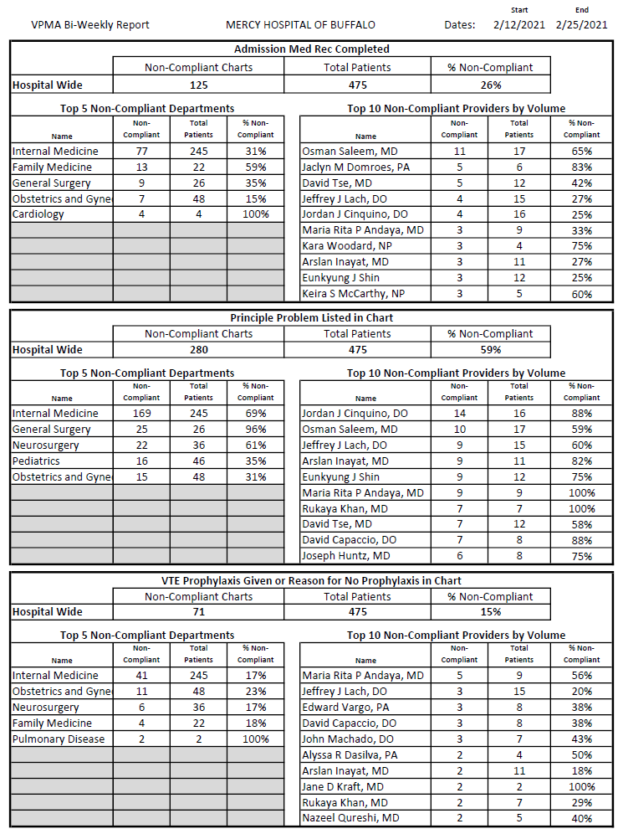
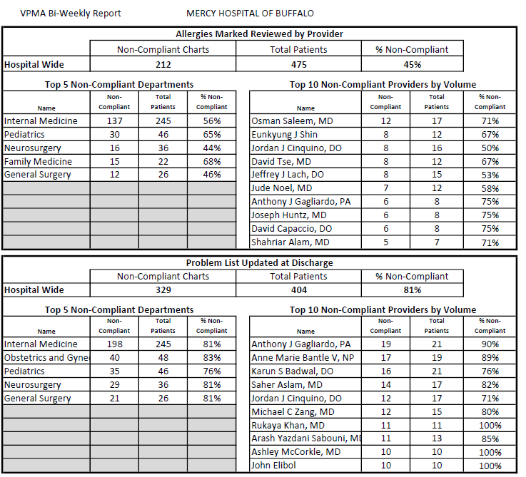
Current Reports
Title

Slide 10
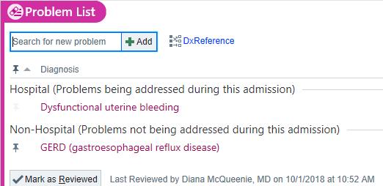
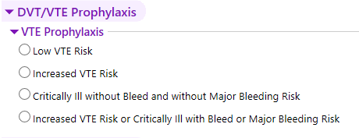
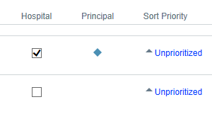
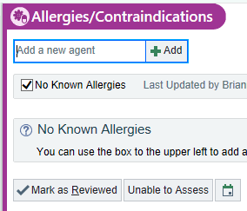
Admission Navigator: Your Key to Completing All Documentation in one Place
Problem List
Medication
Reconciliation
Principle
Problem
Admission
Navigator
VTE
Prophylaxis
Medical History
Review
Allergy
Review

Slide 11
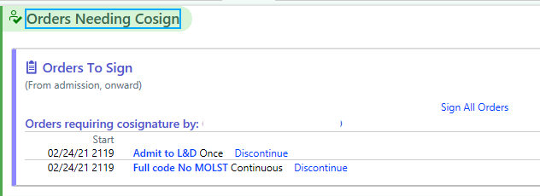
Discharge Navigator: Your Key to Completing All Documentation in one Place
Problem List
Medication
Reconciliation
Principle
Problem
Discharge
Navigator
Cosign Orders
Discharge Summary
Instructions

Slide 12
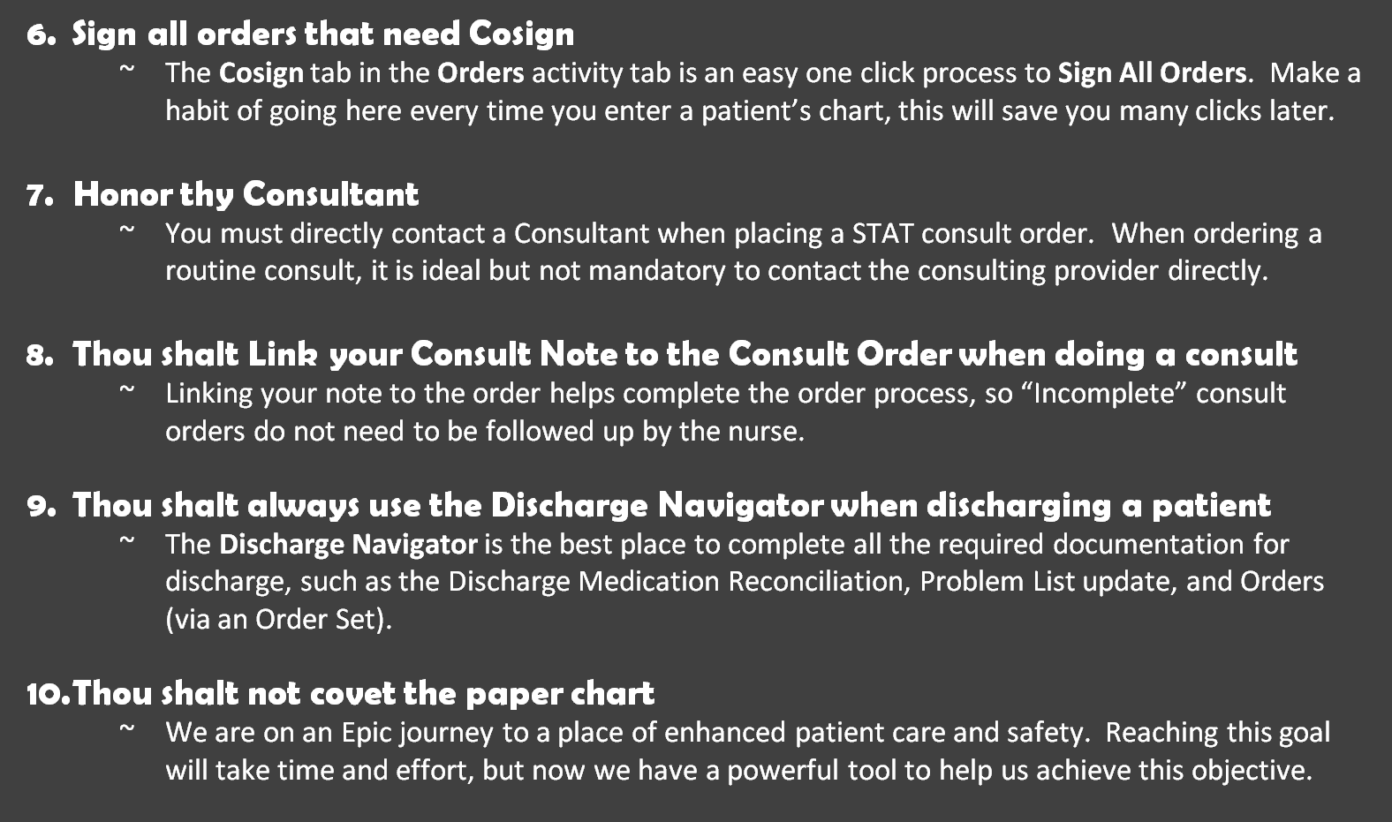
The Ten Commandments for Good Charting in Epic (and how to avoid Joint Commission hell)

Slide 13
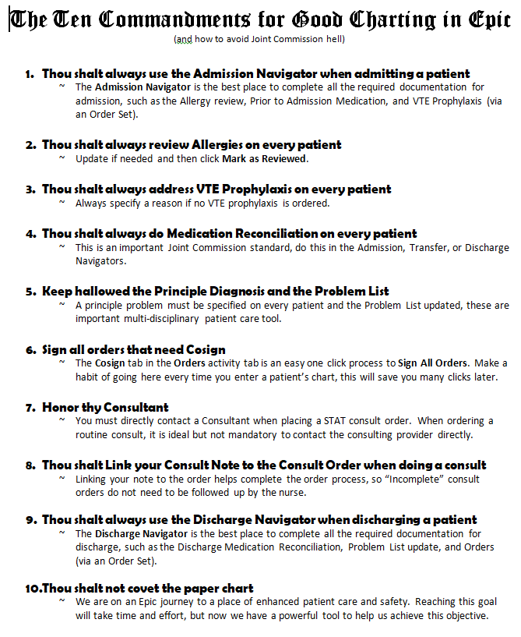
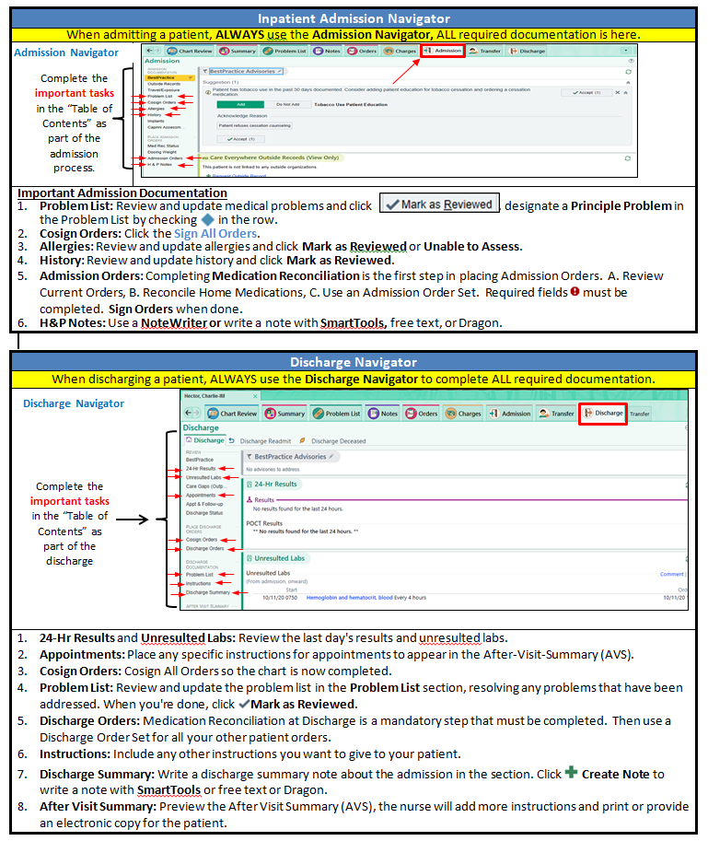
Provider Education

Slide 14
Next Steps in Provider Education
&
Questions
Discussion

